Slide 1



Knowledge-Aware Commonsense Reasoning for Natural Language Understanding and Generation
Yuchen Lin
University of Southern California
Information Science Institute
yuchen.lin@usc.edu
Dec. 17, 2019
Tsinghua University

Slide 2
What is Commonsense Reasoning (CSR)?
Teach machines to reason with common sense!
The human ability to understand and create everyday scenarios in our daily life.
The computation process of manipulating commonsense knowledge to make compositional logical inference.
  Physical world and logics
  Human behaviors / social conventions
Notes:
Generally, we think CSR is to teach machines to reason with common sense. I know! This definition is quite vague, right? Like, what do you mean by “reason” and what do you mean by “commonsense”. Yeah, it IS very hard to give a very clear definition of this area.
Because CSR is not like MT or IE, which have very clear problem settings and you know the input and output, then you only focus on the methods part.
But in CSR, people are still proposing new problems, as they have different explanation of commonsense and reasoning.
Fortunately, we do have some common beliefs: 1) CSR is a human …, 2) and from another perspective, it is also a computation process of ….
And we know the scope of the knowledge

Slide 3
Example CSR problems in NLP
NLU: Multi-choice QA (w/o context)
Where do adults usually use glue sticks?
A: classroom B: office C: desk drawer
NLG: Constrained Sentence Generation (w/ a set of keywords)
Generate a daily-life scene about a concept-set: {apple, bag, tree}
A boy picks some apples from a tree and puts them into a bag.

Slide 4

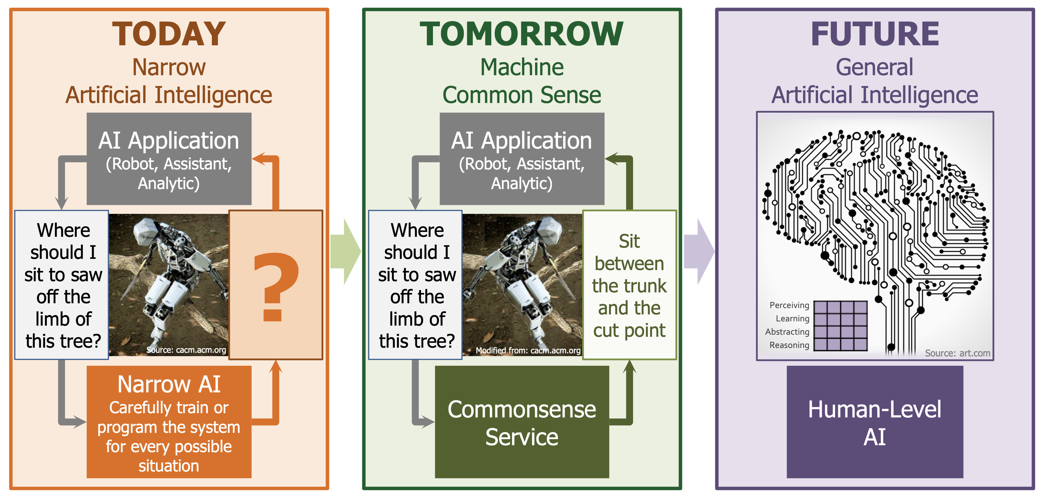
Why do we care about CSR?
Credit: https://www.darpa.mil/program/machine-common-sense

Slide 5
Outline
Part I: Discriminative Commonsense Reasoning
  Improving NLU with commonsense
  A detailed case of CommonsenseQA and KagNet
  Analysis and future directions
Part II: Generative Commonsense Reasoning
  Imposing commonsense to NLG
  A new task & dataset: CommonGen
  Methods and Evaluation

Slide 6
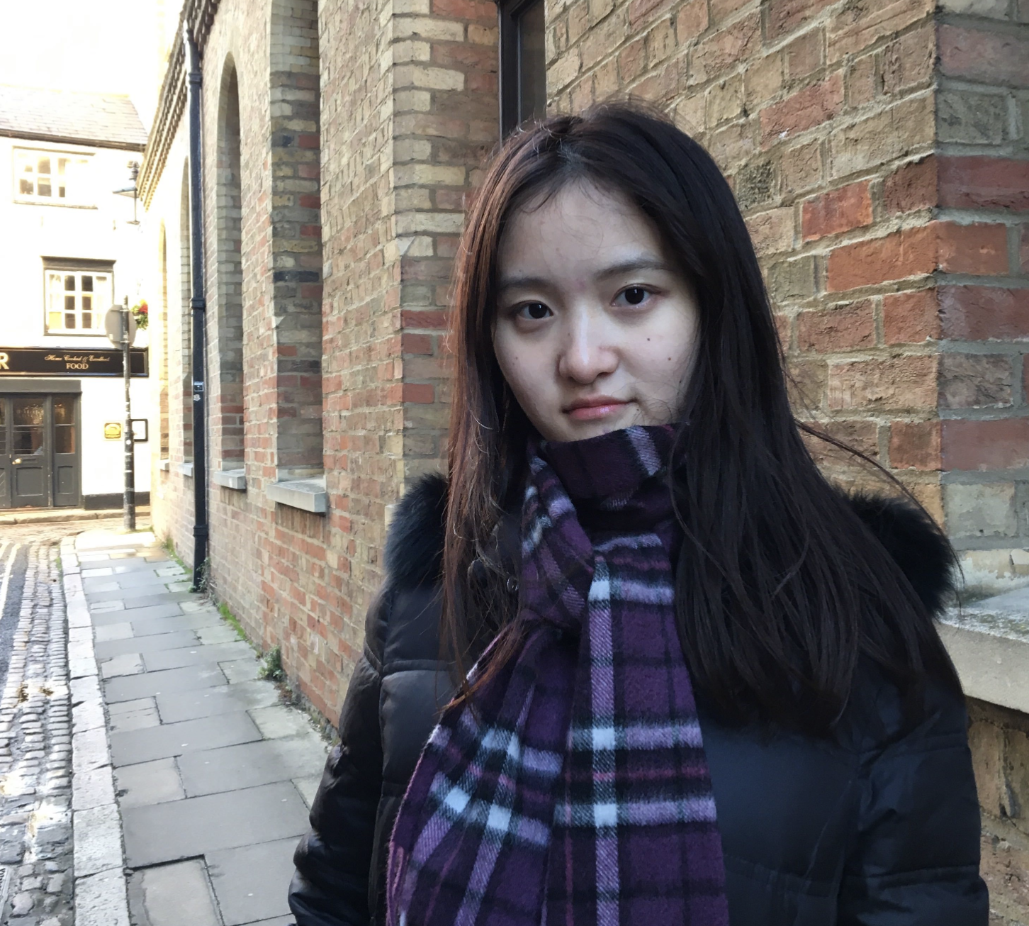
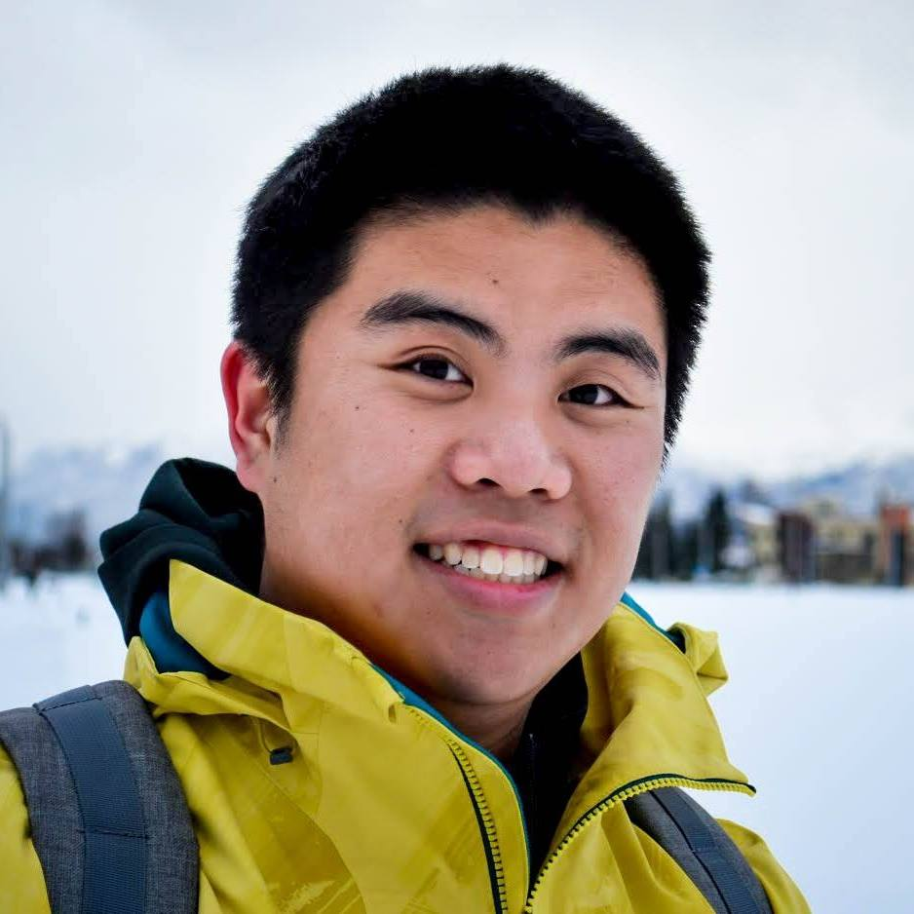

Part I
KagNet:
Knowledge-Aware Graph Networks
for Commonsense Reasoning
Bill Yuchen Lin Xinyue Chen Jamin Chen Xiang Ren
University of Southern California - Information Science Institution
INK Lab @ USC-ISI
http://inklab.usc.edu
EMNLP-IJCNLP 2019
Hong Kong, China

Slide 7
Commonsense Question Answering
Where do adults usually use glue sticks?
A: classroom B: office C: desk drawer
What do you need to fill with ink to write notes on an A4 paper?
A: fountain pen B: printer C: pencil
Can you choose the most plausible answer based on daily life commonsense knowledge?
(Bill Yuchen Lin et al. 2019)

Slide 8
Commonsense Question Answering
Where do adults usually use glue sticks?
A: classroom B: office C: desk drawer
What do you need to fill with ink to write notes on an A4 paper?
A: fountain pen B: printer C: pencil
From the CommonsenseQA dataset (Talmor et al. NAACL 2019)
Research question:
How can we impose commonsense in NLU models?
(Bill Yuchen Lin et al. 2019)

Slide 9
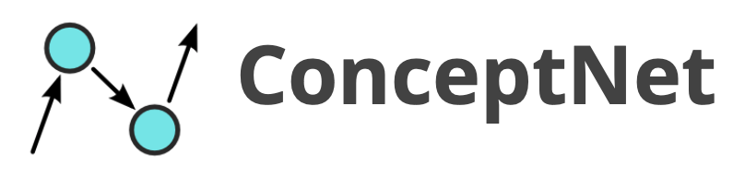
Knowledge-Aware Reasoning
adult
CapableOf
use
Symbol Space
ReceiveAction
CapableOf
glue_stick
work
HasSubevent
A Schema Graph
for the choice B
AtLocation
AtLocation
office
Grounding
Knowledge-Aware Reasoning*
Semantic Space
Where do adults use glue sticks?
Question
A: classroom B: office C: desk drawer
Answer Candidates
(Bill Yuchen Lin et al. 2019)

Slide 10
Challenges in knowledge-aware reasoning
How can we find the schema graphs?
  Noisy and Incomplete
  Numerous graphs; how to select the most related ones
How do we encode these graphs for reasoning?
  Complex multi-relational graph structures
  NO supervision in aligning graphs and question-answer pairs
  Need to be compatible with neural sentence encoders
(Bill Yuchen Lin et al. 2019)

Slide 11
Proposed Framework Overview
Statement
Question
Answer
Answer
Concepts
Question
Concepts
Concept Recognition
Language Encoder
(e.g. BERT)
Graph Construction
via Path Finding
KagNet
Statement Vector
Graph
Vector
Graph Encoder*
MLP
Plausibility score
Schema Graph
(Bill Yuchen Lin et al. 2019)

Slide 12
(1) Schema Graph Construction
Concept Recognition
  Tokenization / Lemmatization
  Match ConceptNet vocabulary
  Merge multiple smaller concepts into a longer one
    e.g. `` fountain’’, ``pen’’ --> ``fountain pen’’
  Question Concepts C_{q} and Answer Concepts C_{a}
Path Finding
  Find paths between each QA-concept pair (one from C_{q} and one from C_{a})
    denotes the set of paths between i-th question concept and j-th answer concept
  Path pruning by length (<= 5 nodes) and embedding-based metric.
    Train knowledge graph embeddings (e.g. TransE) for scoring paths
    Choose the highest-score relation by the KGE when there are multiple ones
，
(Bill Yuchen Lin et al. 2019)

Slide 13
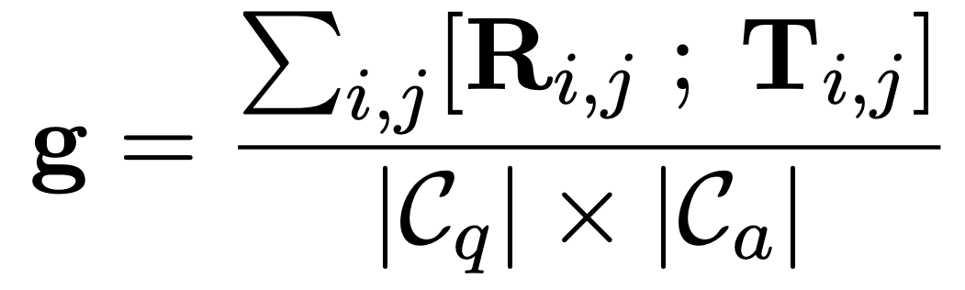
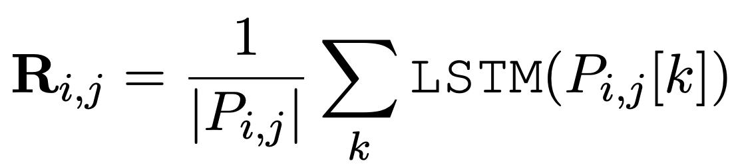
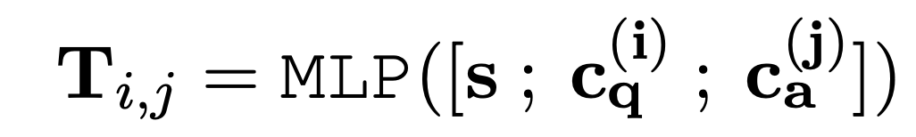

(2) Path-based Relational Graph Encoder
Encoding Unlabeled
Schema Graphs
Statement Vector
LSTM Path Encoder
LSTM( )
…..
Graph Conv. Nets
Modeling Relational Paths between
and
only looking at
the plain graph structures
(i.e. ignore relations)
the k-th path between
and
(Bill Yuchen Lin et al. 2019)

Slide 14
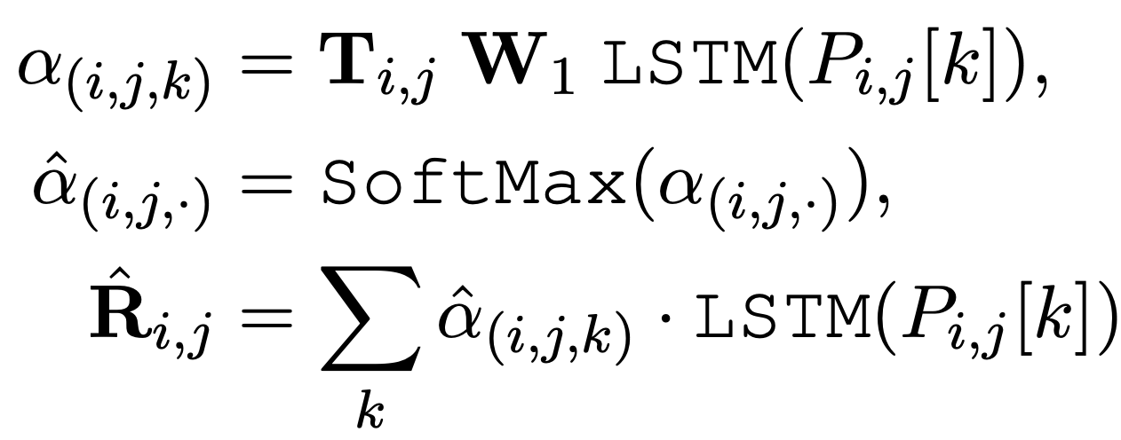
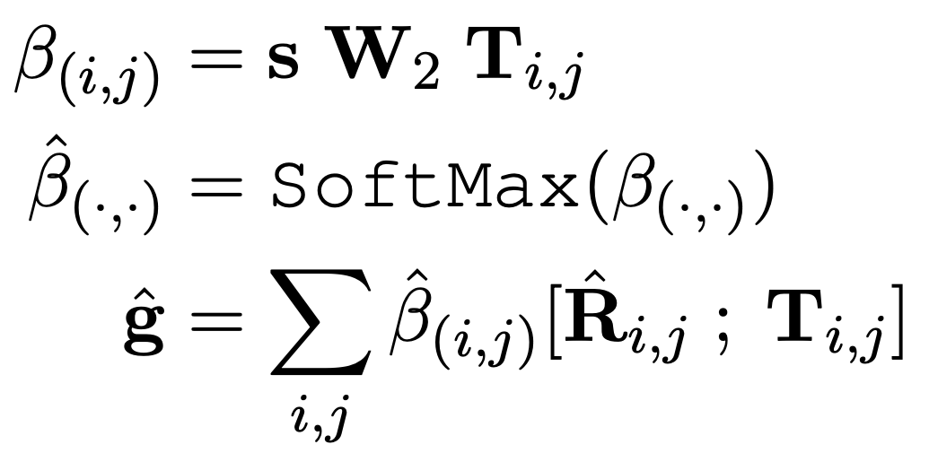
(3) w/ Hierarchical Path-based Attention
Two average pooling:
  Assuming all QA-concept pairs are equally important
  Assuming all paths are equally relevant
Modeling the two-level importance as latent weights:
Path-Level Attention
(attending on semantic space)
ConceptPair-Level Attention
(attending on statement)
(Bill Yuchen Lin et al. 2019)

Slide 15
Recap: Proposed Framework
Statement
Question
Answer
Answer
Concepts
Question
Concepts
Concept Recognition
Language Encoder
(e.g. BERT)
Graph Construction
via Path Finding
KagNet
Statement Vector
Graph
Vector
Graph Encoder*
MLP
Plausibility score
Schema Graph
(Bill Yuchen Lin et al. 2019)

Slide 16
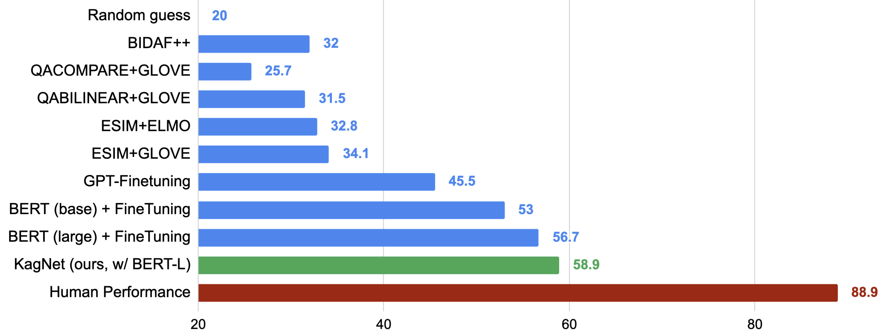
Experiments
Recent follow-up submissions:
Based on XL-NET / RoBERTa (72.1)
Using large-scale wiki docs via IR
Transfer from other QA datasets (e.g. RACE)
Adversarial Data Augmentation
More Performance on Official Test Set: https://www.tau-nlp.org/csqa-leaderboard
(Bill Yuchen Lin et al. 2019)

Slide 17
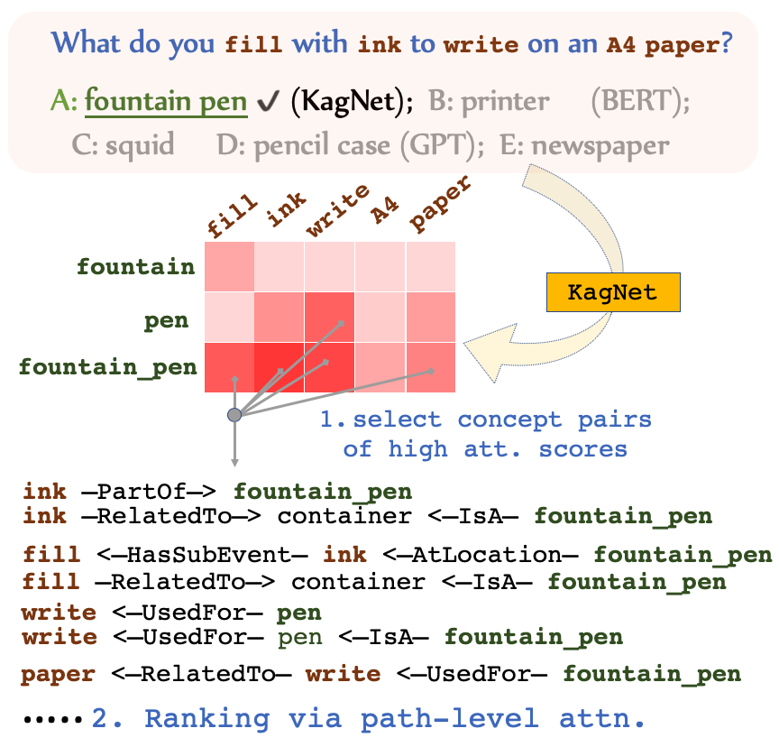


Interpretability
Transferability
KagNet
BERT-Large
Training!
CSQA
59.01% vs 56.53%
53.51% vs 51.23%
SWAG
No Training!
WSC
(Bill Yuchen Lin et al. 2019)

Slide 18
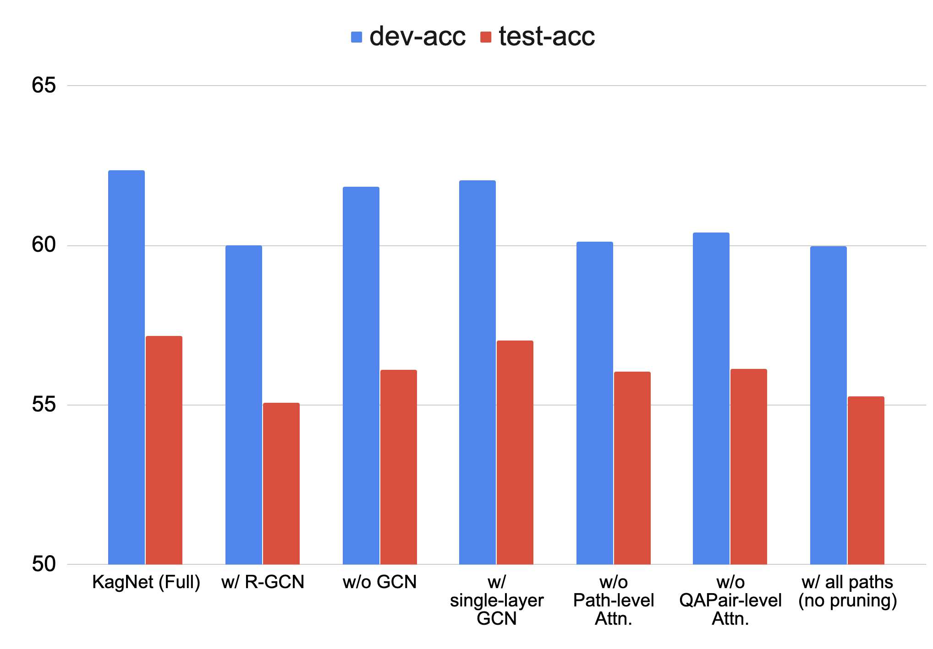
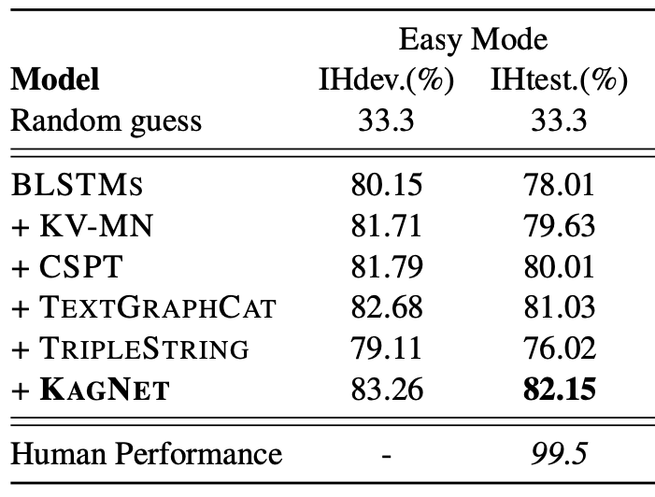
Experiments (cont.)
Easy mode:
wrong answers include some random chosen concepts
Comparisons with other knowledge-aware methods
KV-MN = (Mihaylov and Frank, ACL 18)
CSPT = (Zhong et al. 2019)
TextGraphCat = (Wang et al. AAAI 18)
TripleString = Transform triples to sentences
Ablation Study: R-GCN, # of layers, # Attentions
(Bill Yuchen Lin et al. 2019)

Slide 19
Conclusion
A novel framework for knowledge-aware commonsense QA
A graph neural network for relational reasoning.
  GCN + Path-based LSTM + Hierarchical Attention
  Promising for other reasoning tasks over graphs (e.g. GQA)
Future directions in commonsense reasoning:
  Towards Learnable Graph Construction (instead of heuristic algs.)
  Explicitly deal with negations (“not”, “but”, etc.) and comparisons (“largest”, “most”, etc.).
    Logical forms, executable semantic parsing.
  Interactively reasoning over a sequence of questions
Our code is at https://github.com/INK-USC/KagNet
(Bill Yuchen Lin et al. 2019)

Slide 20
Part II
CommonGen:
Towards Generative Commonsense Reasoning via A Constrained Text Generation Challenge
Bill Yuchen Lin, Ming Shen, Yu Xing, Pei Zhou, Xiang Ren
http://inklab.usc.edu/CommonGen
University of Southern California - Information Science Institution
INK Lab @ USC-ISI
http://inklab.usc.edu

Slide 21
Motivation
Is multi-choice QA a best way to go for testing MCS?
  1）Annotator bias in creating distractors (Geva et al., 2019)
  2）Limited space for commonsense reasoners to explore
  3）Overly similar objectives with BERT-like pre-trained LMs
  4) Less realistic in downstream applications
  SWAG (Zellers et al. 2018)
    Input: a first scene, and four possible next scenes
    Output: the index of the most plausible next scene
    Similar to the NextSentencePrediction in BERT-like pretraining
  CSQA (Talmor et al. 2019)
    Input: a question (usually, what/where/which/why), and five possible answers (usually a word or a short phrase)
    Ouput: the index of the most plausible choice
    Similar to the Masked-LM objective in BERT-like pretraining

Slide 22
Generative Commonsense Reasoning?
Commonsense Reasoning in NLU:
  SWAG, CODAH, CSQA, Social IQA, ROC Stories, CosmosQA, etc.
  Most are discriminative (i.e. multi-choice QA)
Commonsense Reasoning in NLG?
  Most are L2R Language modeling
  Story generation
  COMET (If-then, ATOMICs)
What about a constrained text generation task?
  NLU --> NLG

Slide 23

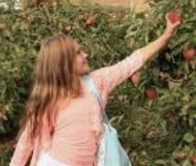


Proposed Task for Generative CSR via Constrained Text Generation
apple (noun) place (verb) tree (noun) pick (verb) bag (noun)
A concept-set
Generative
Commonsense
Reasoning
Rationales (i.e. commonsense knowledge):
- apples grow in trees;
- ﻿bags are containers that you can put something in;
- ﻿you usually pick sth. and then place it in a container;
Scenes
A boy picks some apples from a tree and places them into a bag.
A boy picks some bags from a tree and places apples into them.
A boy picks some apple trees and places them into bags.
Two girls place some apples on a tree and pick some bags.
……..

Slide 24
Potential Applications
Modeling P (scene | a set of concepts)
Vision Tasks with Scene Understanding
  Objects are easier to be detected, while the scene may still hard to understand.
    Visual Captioning (i.e. image/video captioning)
    Visual QA and commonsense reasoning (GQA, VCR, etc.)
Dialogue systems
  Generating less nonsense response
Topic-based Storytelling
Machine Translation

Slide 25
Unique Challenges in CommonGen
The output sentence should:
  Covering all given concepts w/ required POS (place: verb. vs. noun)
  The decoding order is not given/pre-fixed.
  Allowing morphological changes (pick → picks)
  Describe everyday scenarios (w/ high commonsense plausibility)

Slide 26
Dataset Construction
Key criteria of the concept-sets and sentences
  The output sentence should cover all given concepts
  The sentence is supposed to describe a natural, common scene
  The given concepts are likely to be present together in the same scene of our daily life.
  Need to be large-scale!
→ Image/Video Captions!!
  Pros: the caption sentences are human-written, large scale, reflect common scenes in daily life.
  Cons: some of them can be over-specific, and thus noisy for testing models.

Slide 27
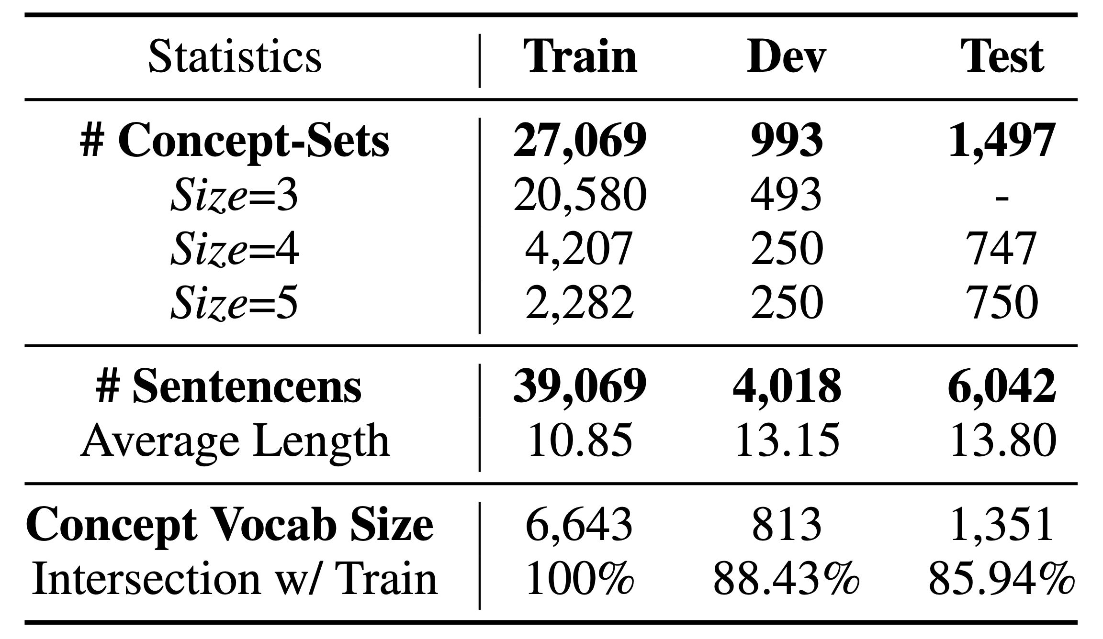
Dataset Construction
concept-set (3~5) co-occurrence
Caption Corpora
LSMDC (Rohrbach et al., 2017)
ActivityNet (Krishna et al., 2017)
VATEX (Wang et al., 2019)
MSCOCO, Flickr30k, etc.
(apple_N, tree_N, pick_V): 55
(apple_N, tree_N, pick_V, bag_N): 15
…
Scoring &
Sampling
AMT
train
dev
test

Slide 28
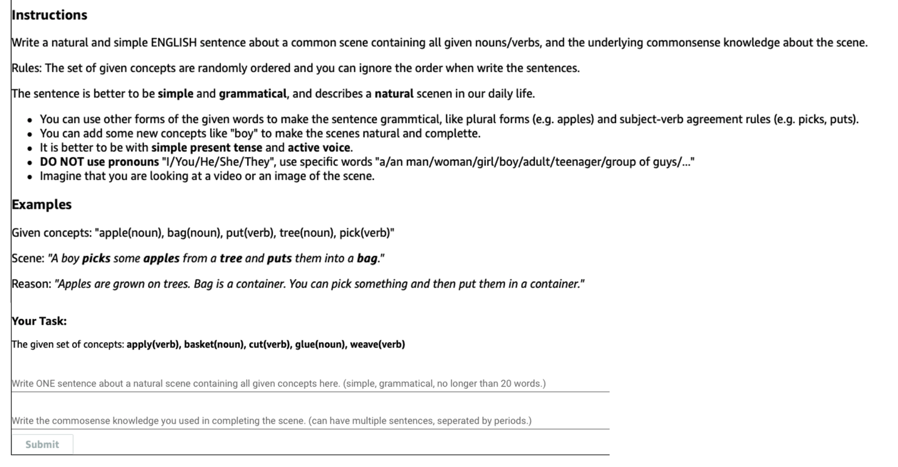
Annotation Interface via AMT
rationales

Slide 29
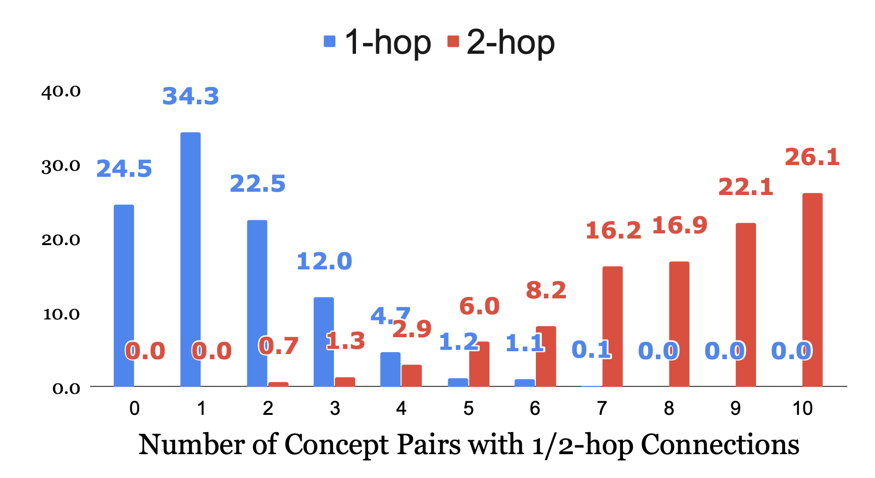
Connectivity Analysis
A 5-size concept-set
Any 1/2 –hop links on ConceptNet?

Slide 30
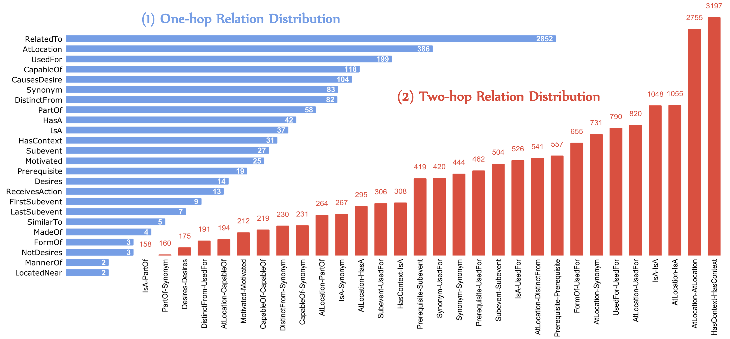
Relation Dist. Analysis
spatial knowledge (Atlocation, LocatedNear)
object properties (UsedFor, CapableOf, PartOf, ReceivesAction)
human behavior and social conventions (CauseDesire, MotivatedByGoal)
temporal knowledge about events (First/Last-SubEvent, Prerequisite)
other general commonsense (RelatedTo, HasContext, IsA)

Slide 31
Baseline Methods (1/2)
Over-simplifications:
  Convert concept-sets to randomly ordered concept-seqs
  Ignore the requirement of part-of-speech
Conventional Seq2seq models
  Bidirectional RNN-based Encode-Decoder (bRNN)
  Transformer
  Order-insensitive:
    Mean-pooling over individual MLPs as encoder
    Removing Position Embeddings in Transformer
  w/ Copy Attention Mechanism

Slide 32
Baseline Methods (2/2)
Non-autoregressive Generative Models
  Based on edits (addition, deletion, etc.) for text generation with iterative refinements.
  Levenshtein Transformer (Gu et al. 2019)
  iNAT (Lee et al., 2018)
  Insertion Transformer (Stern et al., 2019)
Pre-trained Text Generation models
  UniLM (Dong et al. 2019)
    BERT as encoder and pre-training with multiple generation objectives

Slide 33
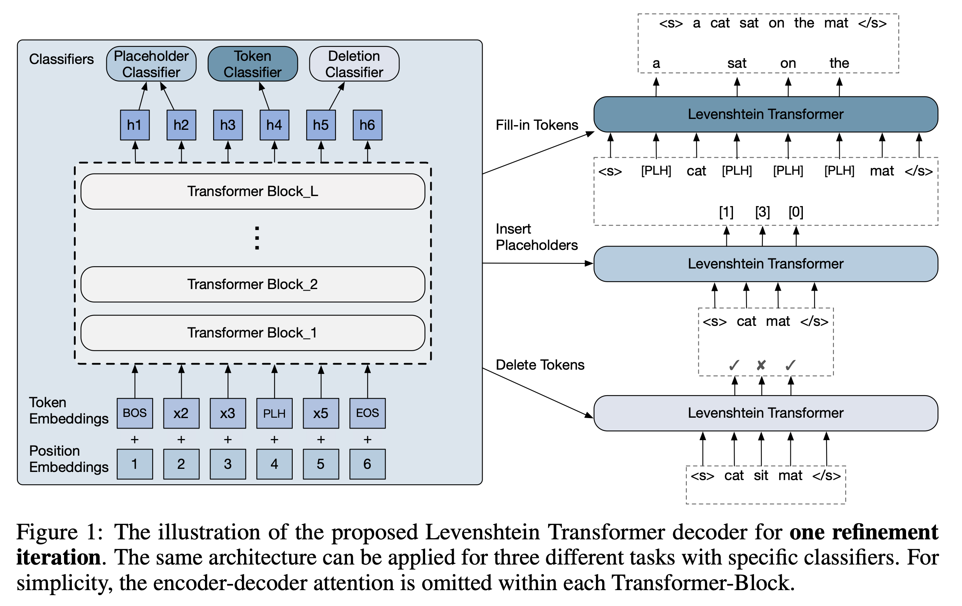

Levenshtein Transformer (Gu et al. 2019): A typical Non-AG model

Slide 34
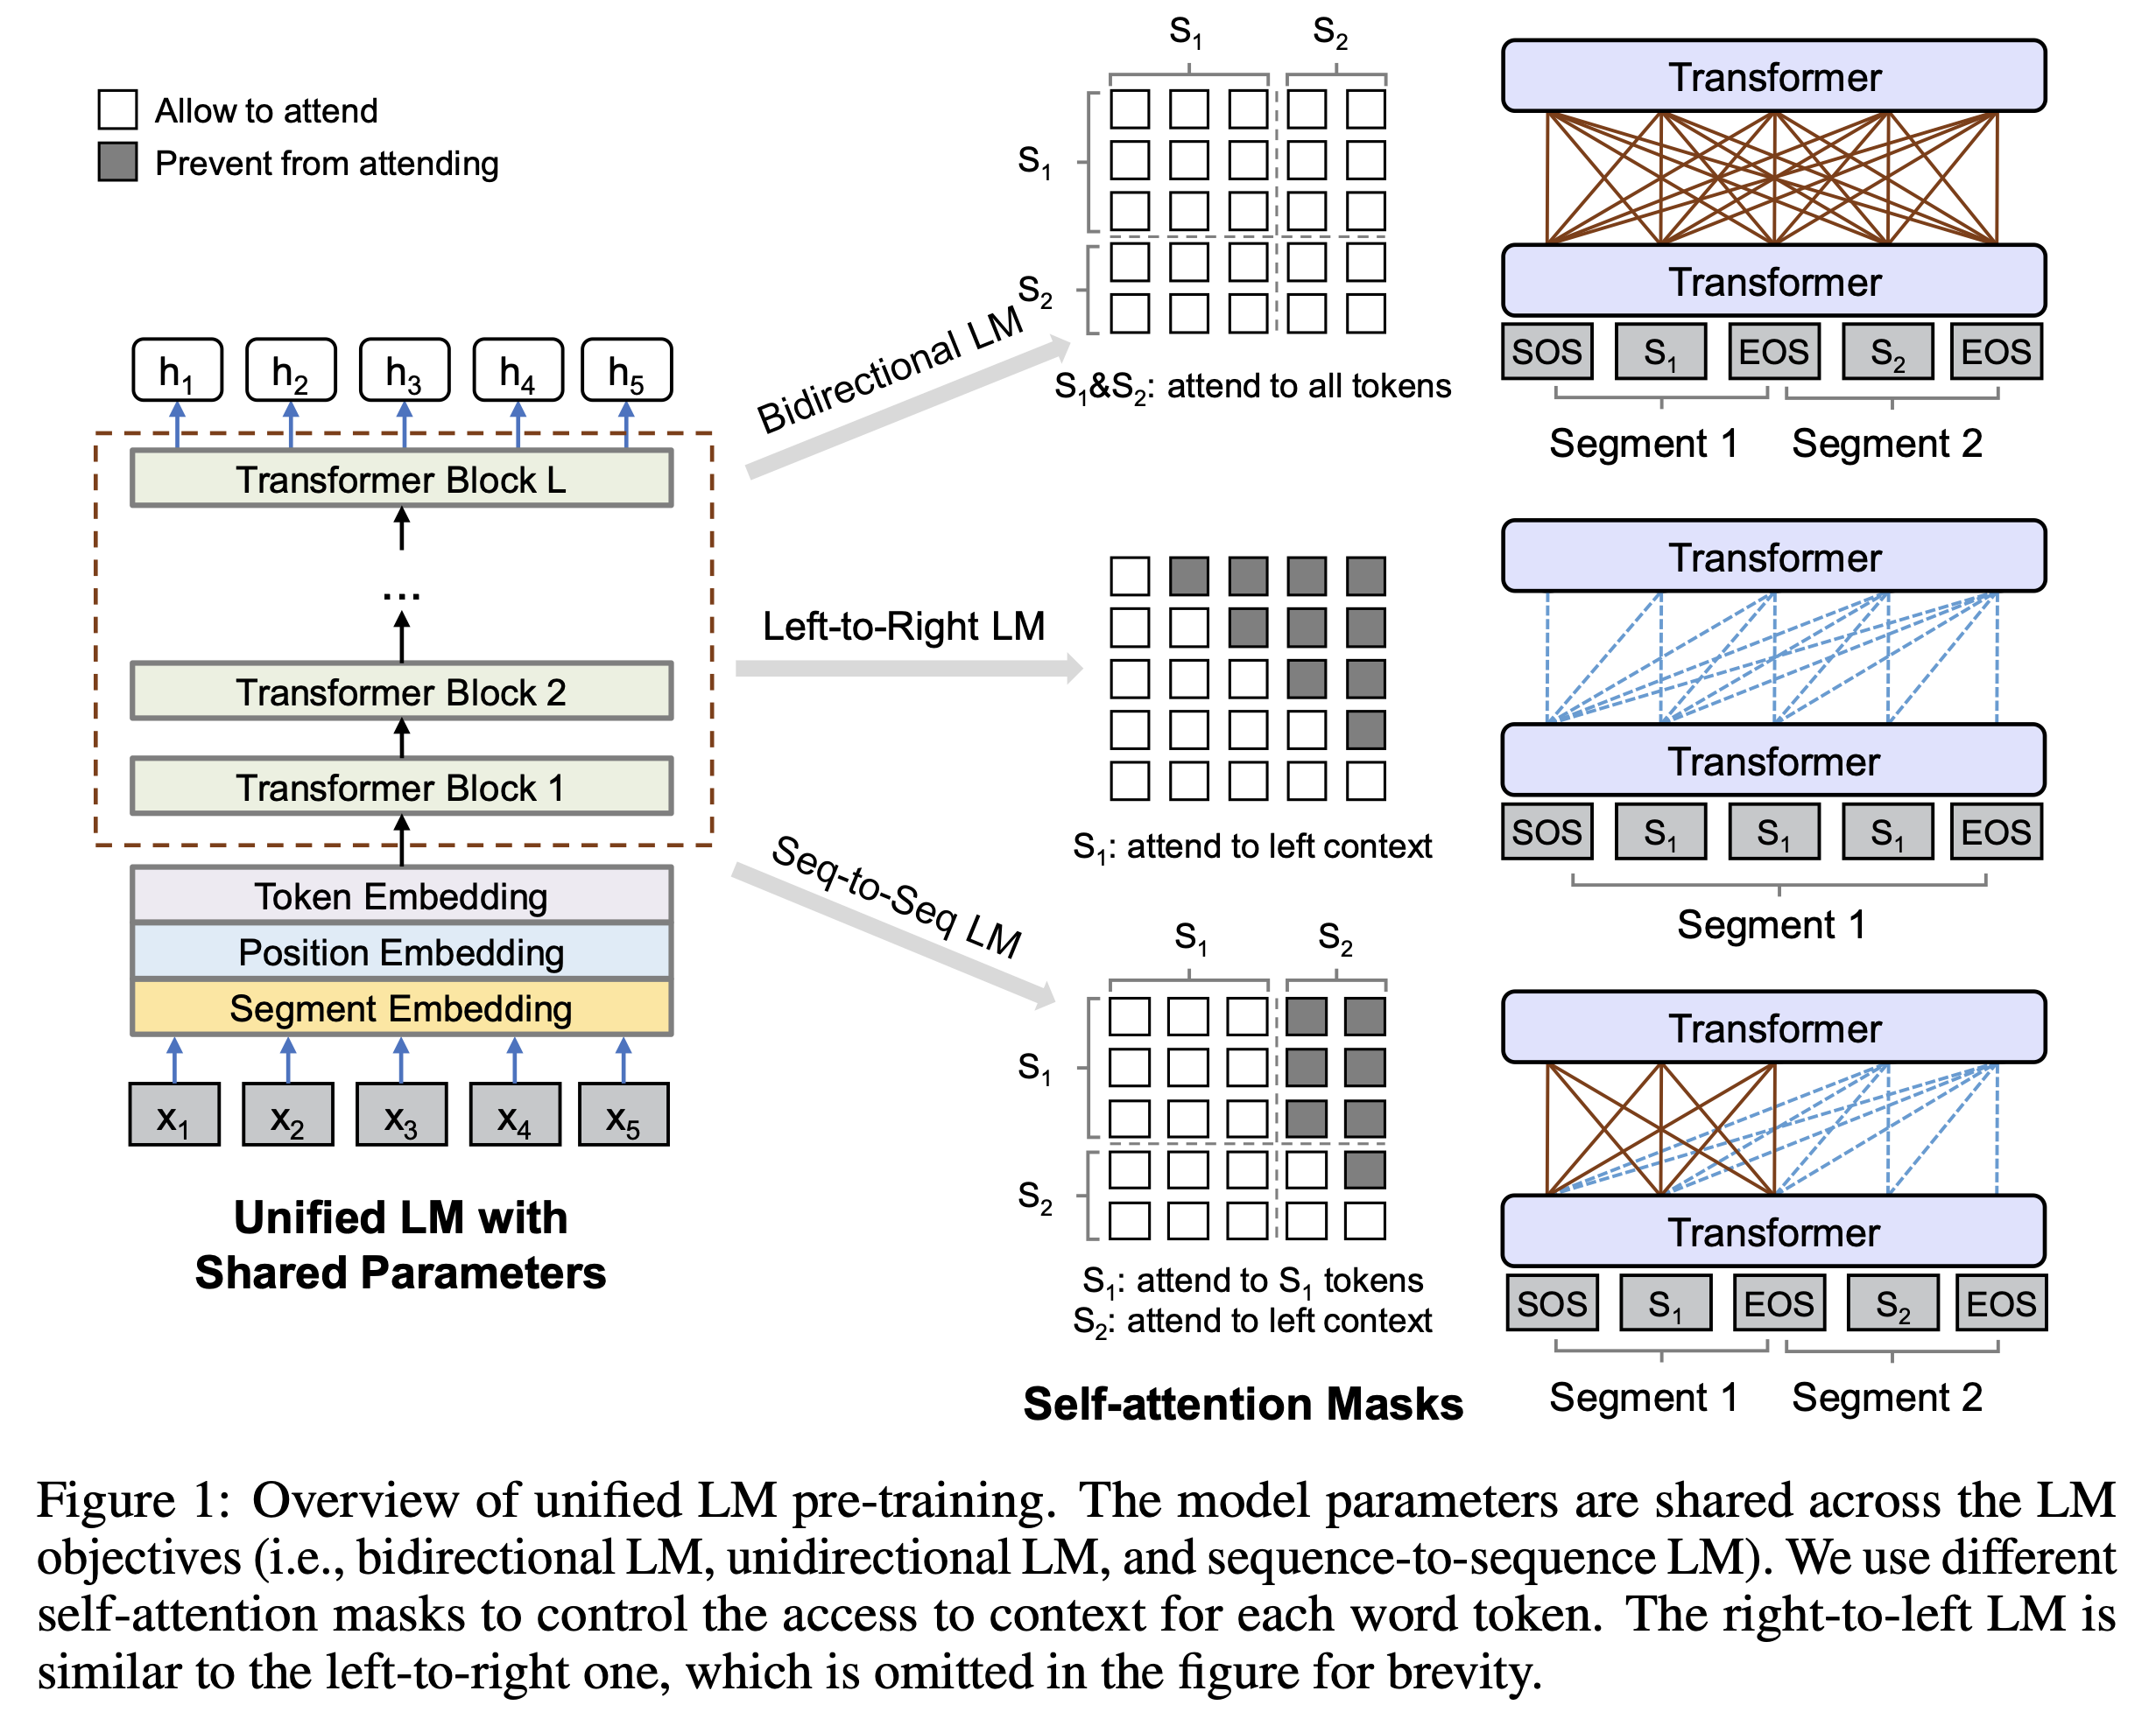
UniLM (Dong et al. 2019): A pre-trained SeqGen Model

Slide 35
Evaluation Metrics
Conventional metrics for generation
  BLEU-3/4, ROUGE-2/L, METER
Metrics for image/video captioning
  CIDEr and SPICE
Task-specific metrics
  Coverage (considering POS tags or just lemma)
  PivotBERT
    PivotScore * BERTScore (Zhang et al., 2019)
Consider each pair of concepts and its shortest path on the dependency parse tree,
and then compute the recall score between prediction trees and reference trees

Slide 36
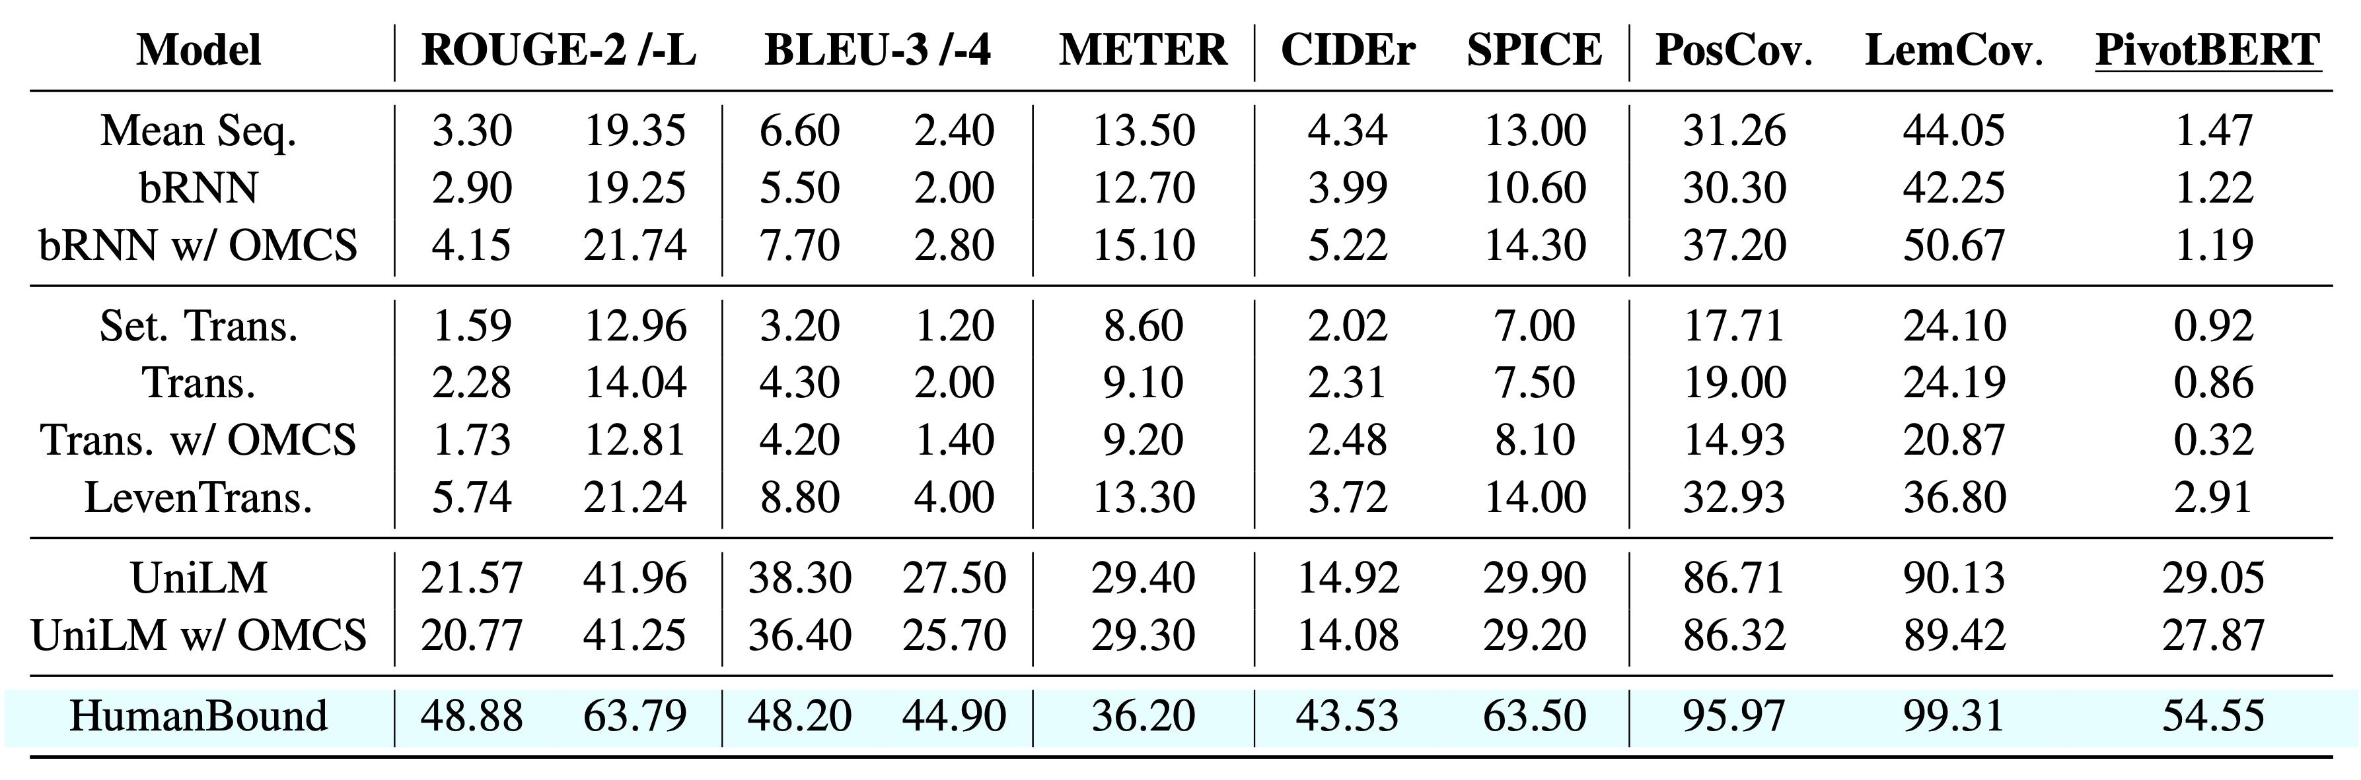
Experimental results (Automatic)
OMCS: a corpus that contains a large amount of single-sentence commonsense facts. We use Elasticsearch for including them as additional input.

Slide 37
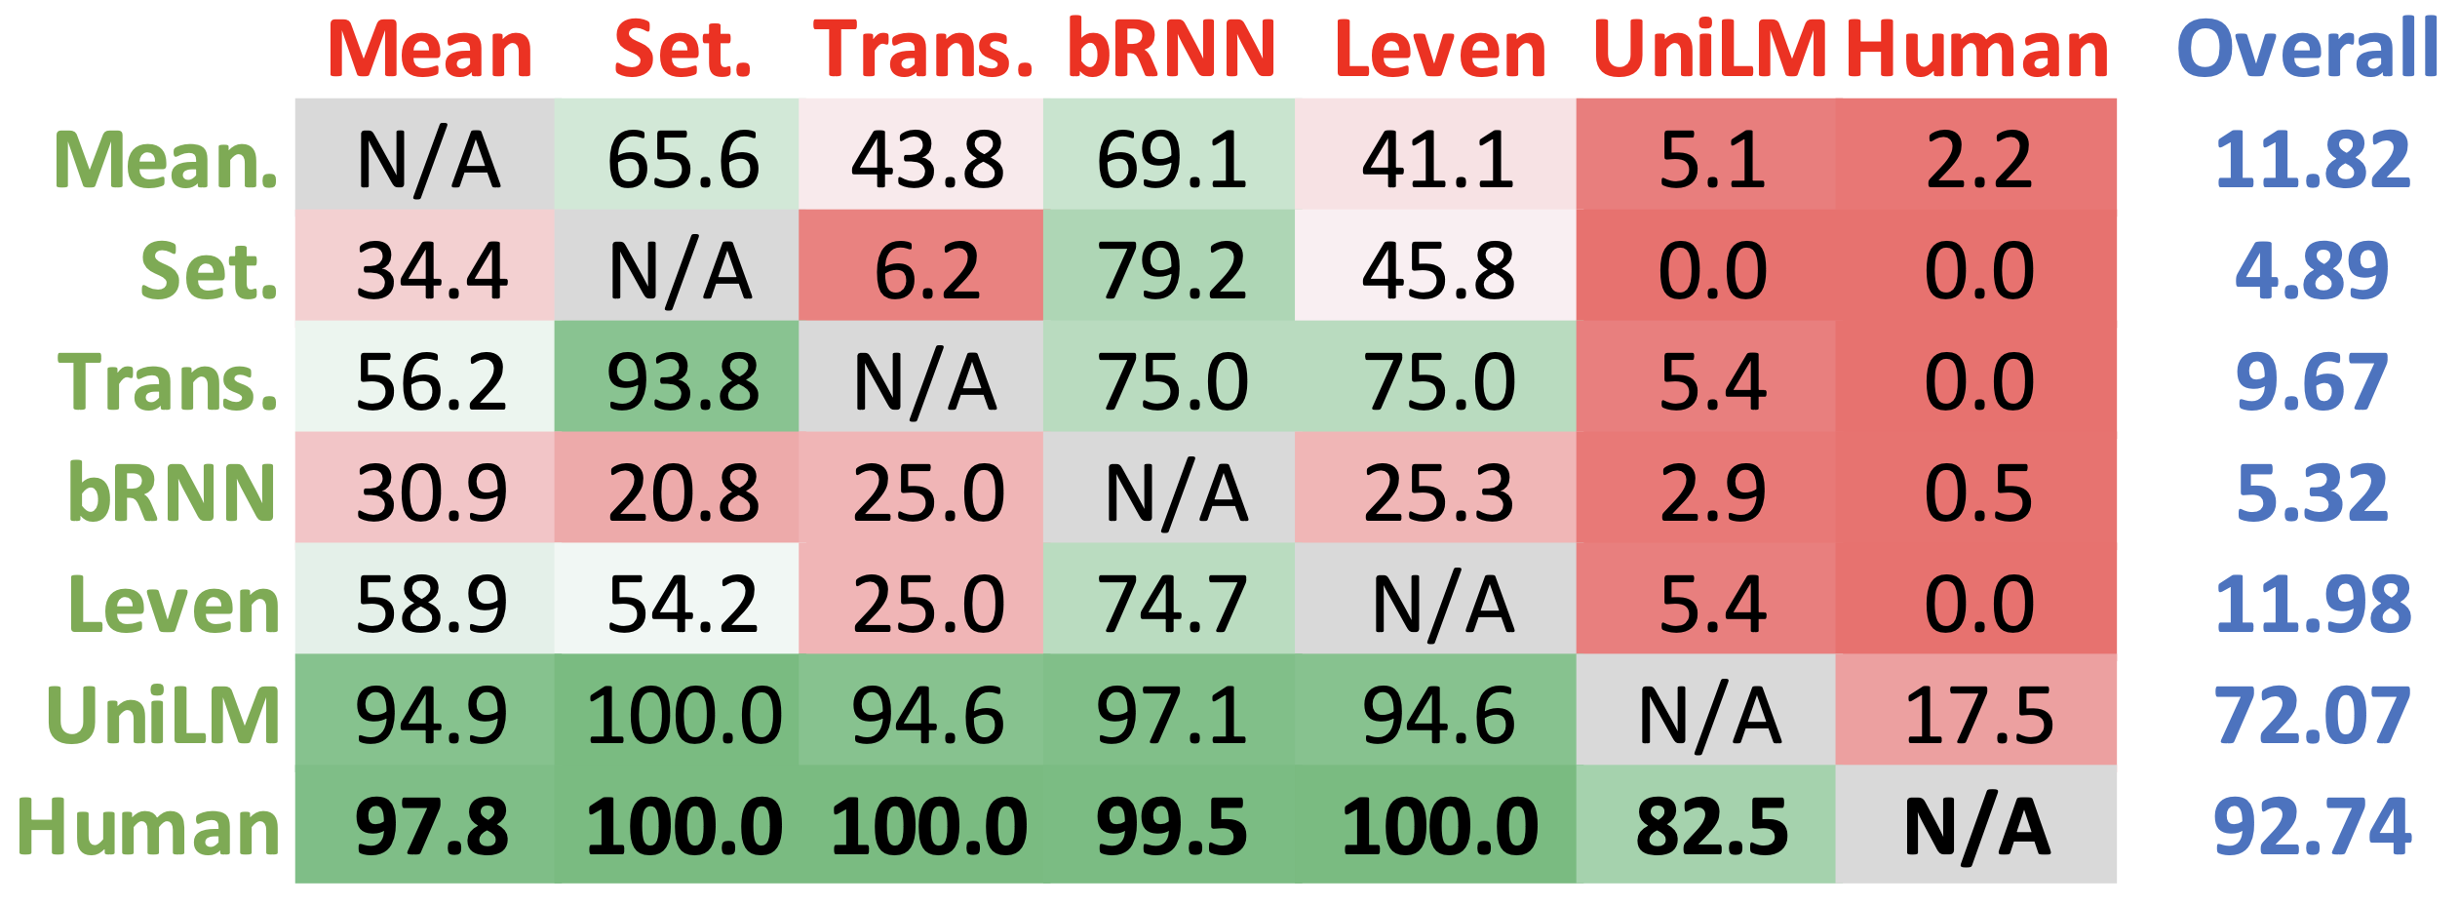
Experimental results (Human)
Human annotators are given a pair of sentences (w/ the same coverage) to compare.

Slide 38

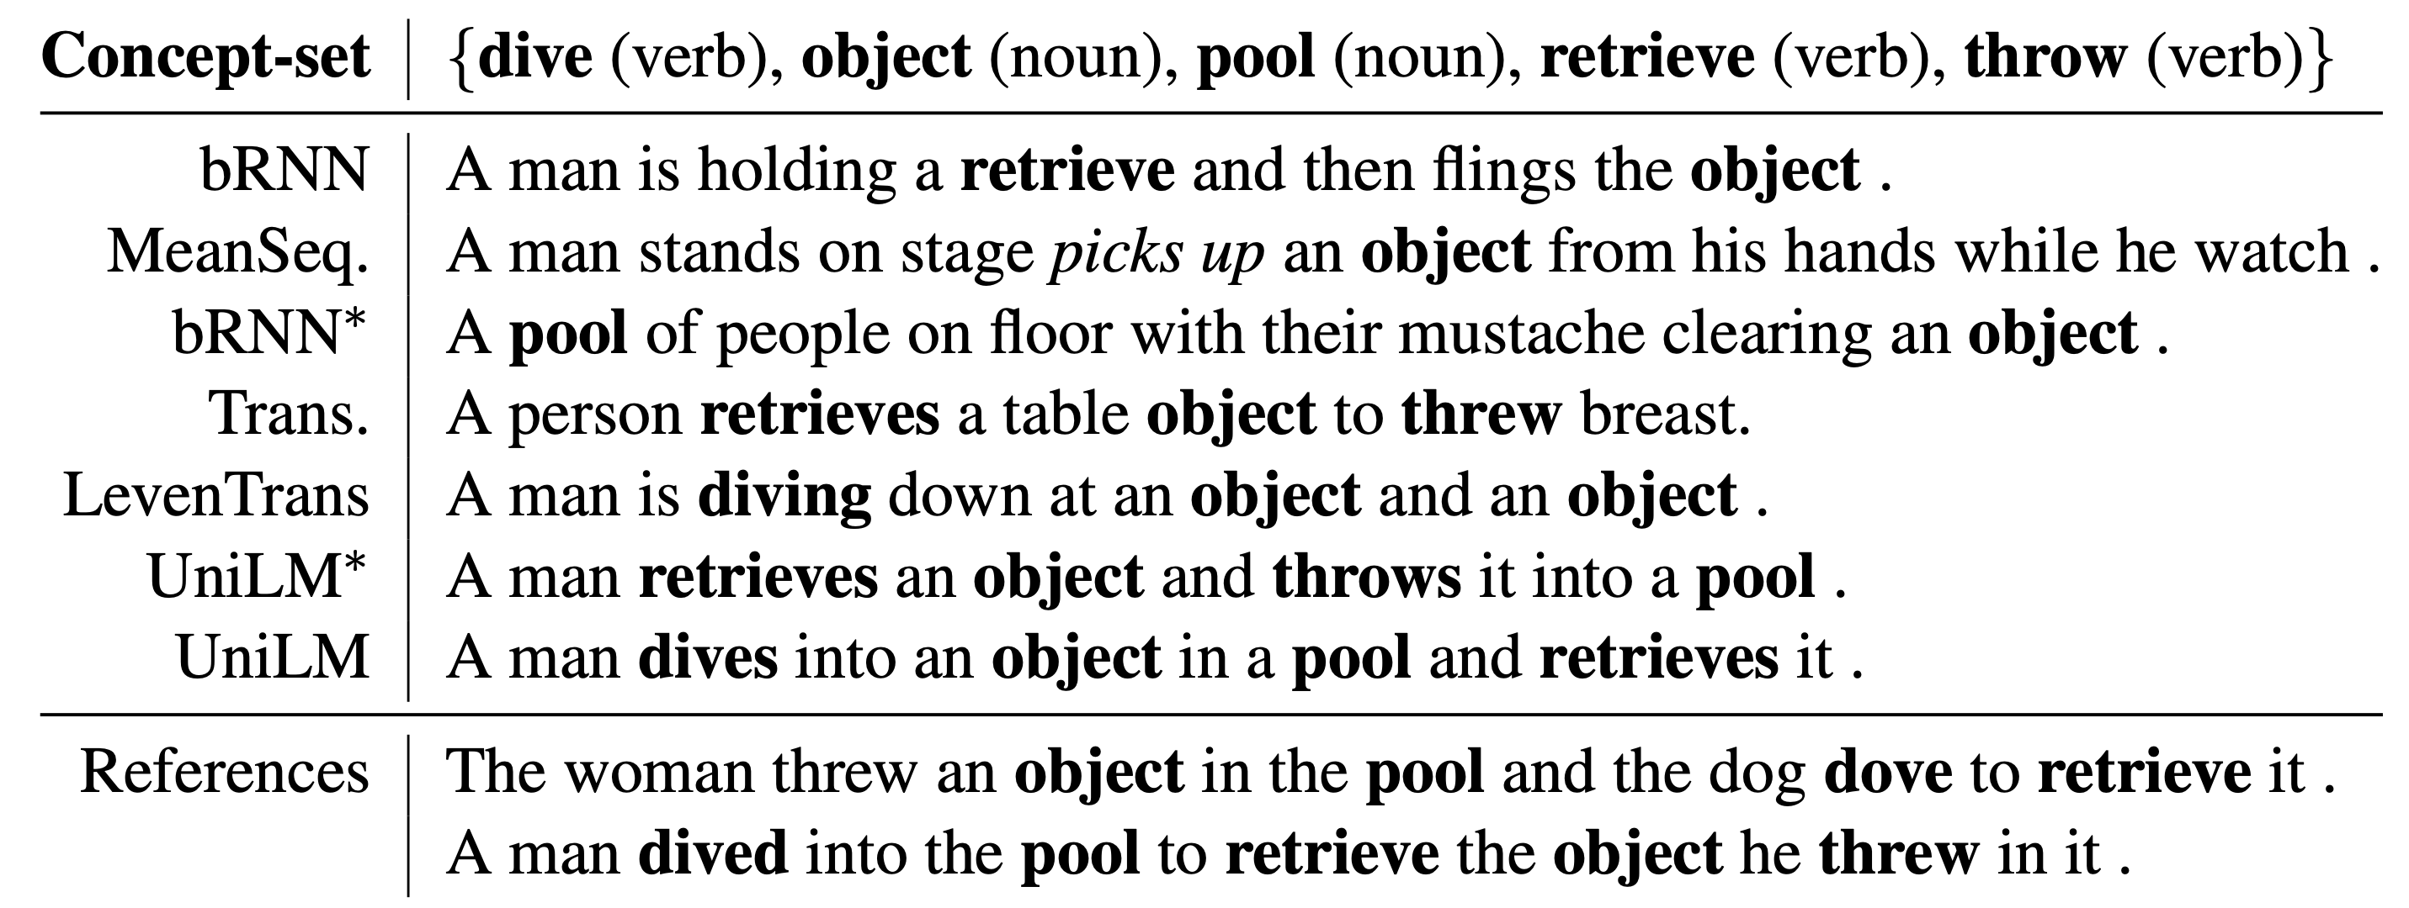
Case study

Slide 39
Conclusion and Future works
Generative commonsense reasoning is still worthy exploring, especially under weak supervision (captions & OMCS facts) via constrained text generation.
Pre-trained SeqGen model (e.g. UniLM) is much powerful than others, while still not as good as human references.
  Maybe pretraining a Keywords-LM is better?
New auto-metrics focused on commonsense plausibility?
Downstream applications in NLG?

