Slide 1
Learning with Entity Triggers as Explanations for Named Entity Recognition
TriggerNER:
ACL 2020
Notes:
Hi everyone, my name is Bill Yuchen Lin.
I’m presenting our short paper on learning with entity triggers for NER.
This is a joint work by USC and Amazon.

Slide 2
A motivating example of Named Entity Recognition (NER) and Entity Triggers
Tom had a fantastic dinner at rumble fish yesterday, where the sushi was the best in my opinion.
Entity Types
PERSON
RESTAURANT
STREET
…
Notes:
Let’s start with a motivating example for the task of NER and the concept of Entity Triggers.
We can see a sentence here: Tom had a fantastic dinner at rumble fish yesterday, where the sushi was the best in my opinion.
And we want to extract the entity names in this sentence. Say, we are interested in several types of entity like Person, Restaurant, Street.

Slide 3
A motivating example of Named Entity Recognition (NER) and Entity Triggers
Why can we recognize it as a restaurant entity?
Tom had a fantastic dinner at rumble fish yesterday, where the sushi was the best in my opinion.
B-PER O O O O O B-REST I-REST O
O O O O O O O O O
Entity Types
PERSON
RESTAURANT
STREET
…
NER as Sequence Tagging
B-X: Beginning of an entity of type X
I-X: Inside an entity of type X
O: Outside of any entities.
→ Boundary + Type
Notes:
Let’s start with a motivating example for the task of NER and the concept of Entity Triggers.
We can see a sentence here: Tom had a fantastic dinner at rumble fish yesterday, where the sushi was the best in my opinion.
And we want to extract the entity names in this sentence. Say, we are interested in several types of entity like Person, Restaurant, Street.
Then, obviously, we can see Tom here is a person, and Rumble Fish should be a restaurant. And we don’t have any street name in this sentence.
We usually consider NER as a sequence tagging problem. That is, we can give each token a tag, which indicates both the boundary and type of each entity span.
A natural question here is that Why can we recognize rumble fish as a restaurant name?
We believe answering this question is significant to efficiently learn a NER model.

Slide 4
A motivating example of Named Entity Recognition (NER) and Entity Triggers
B-REST I-REST
Tom had a fantastic dinner at rumble fish yesterday, where the sushi was the best in my opinion.
Notes:
So in this paper, we want to introduce the concept of entity triggers.
If we look at this particular entity, rumble fish.

Slide 5
A motivating example of Named Entity Recognition (NER) and Entity Triggers
B-REST I-REST
Tom had a fantastic dinner at rumble fish yesterday, where the sushi was the best in my opinion.
1
2
Entity Triggers:
A group of words that can help explain the recognition process of a particular entity in the same sentence.
--> More label-efficient and interpretable models.
Notes:
We want to introduce the concept of entity triggers.
If we look at this particular entity, rumble fish.
We can find that there are two groups of words in this sentence, which can be seen as explanations for our recognition process.
First “had…. dinner at”,
and secondly “where the sushi”.
We argue that explicitly incorporating such triggers
can make NER models more label-efficient and interpretable.

Slide 6
Learning w/ Entity Triggers
Conventional method:
Annotate Entities spans.
Need a LOT of annotations.
Learning with Triggers:
- Annotate Entities & Triggers.
Need only a FEW annotations.
(1) Alice traveled a lot to Beztu Pylsur.
B-PER B-LOC I-LOC
(1) Alice traveled a lot to Beztu Pylsur.
B-PER B-LOC I-LOC
(2) Bob used to travel to Hei Long Jiang.
B-PER B-LOC I-LOC I-LOC
Model
Training
w/ Ent. + Trig.
+
Less
Effort
(3) Cam had a great trip to Akureyri.
B-PER B-LOC
More Cost-Effectively!
More Interpretable!
Model
Training
w/ Entities
More
Effort
≈
Notes:
Therefore, in this paper, we propose learning w/ Entity Triggers for NER.
Recall the conventional method to get a NER model for a particular domain.
We need a lot of human efforts in annotating entity spans to train a sequence tagging model.
However, many annotations may follow very similar entity-recognition process.
For example, Alice traveled a lot to blabla. Bob used to travel to … and Cam had a great trip to a location.
We believe once annotators have already labeled the entity, it should be very easy for them to tag the triggers as well, right?
So why don’t we just label the triggers for learning NER models in a more cost-effective way?
Specifically, we want to annotate both entities and triggers.
Then, we learn a NER model by using the triggers as soft rules, which thus can save a lot of human efforts.
And our goal is to have a comparable model but the model learned with triggers is more cost-effective and more interpretable.

Slide 7
Contribution 1 Our Public Resource for Triggers
Crowd-sourced from Amazon SageMaker
(an advanced version of Amazon Mechanical Turk)
https://aws.amazon.com/sagemaker/
Notes:
The first contribution of our paper is a set of trigger annotations for two popular NER datasets, namely CONLL2003 and BC5CDR.
You can see the total number of the triggers and we have around two triggers for each entity on average.
The triggers are collected from the Amazon SageMaker platform.

Slide 8
Contribution 2 TMN: Trigger Matching Networks
He traveled a lot to Beztu Pylsur.
Bidirectional LSTM Networks
Bidirectional LSTM Networks
Structured Self-Attention Layer
Trigger-based
Global Attention
3) Entity Tagger.
Sent. Rep.
Trigger Rep.
Contrastive Loss
CRF-Tagging Layer
(1) Soft Matcher.
(for generalize to
“had a trip to ..”)
Trained by mixing.
(2) Trig. Encoder
He traveled a lot to Beztu Pylsur.
O O O O O B-LOC I-LOC
Classification Loss
? Type = {LOC, PER, …}
More details are in the paper….
Notes:
With these trigger annotations, we propose a simple yet effective trigger-based NER learning framework.
It is called Trigger Matching Networks.
We only briefly introduce the key ideas and please refer to our paper for more details.
We start with this annotated sentence, and we can see the trigger here is travel to.
We input this sentence to a Bidirectional LSTM layer followed by a structured self-attention layer.
Then, we get the sentence representations by mean pooling and also the trigger representations by only considering the trigger words.
We first use the contrastive loss between two representations to learn a soft matcher by mixing matched and mismatched pairs of sentences and triggers.
Such that we can use it for finding the most suitable triggers in the inference time as we don’t know the gold triggers in test examples.
In the meantime, we also ensure the trigger representations can capture the typing information by training with an entity classifier .
Then, we use the learned trigger rep. as a global regularization to control the attention for a BLSTM-CRF model to do the sequence tagging.
Finally. We can extract the target entity.

Slide 9
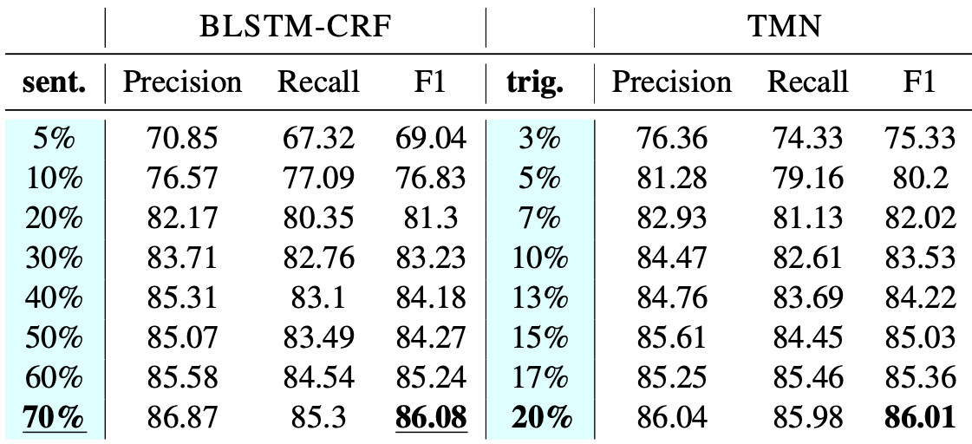
(Part of) Experimental Results
Entity Annotations
Entity + Trigger Annotations
≈
More Cost-Effectively!
More Interpretable!
Notes:
Here is part of our experimental results.
Our major baseline is a standard BLSTM-CRF trained with only entity annotations.
And our method TMN is trained with both entities and the trigger annotations.
We only use 15% of the original data with entity triggers. And TMN can get comparable results with conventional methods using 60% of the data.
Also, we can use 20% of the data to match the performance of using 70% data in the conventional way of learning.
The TMN model is also more interpretable. This is the attention heatmap for visualizing the soft trigger matcher.
We can see the model recognizes the chemical entity using the trigger “per day” which is matched by “once daily”.

Slide 10
Future Directions
Can we transfer existing triggers to low-resource languages?
Can we develop a method to automatically induce triggers?
Can we use the triggers for evaluating interpretability of NER?
Notes:
We believe our work opens a few follow-up research questions:
Such as:
Can
Can
Can

Slide 11
Thank you for listening.
arXiv version: https://arxiv.org/abs/2004.07493
Code and data: https://github.com/INK-USC/TriggerNER
More triggers are coming.
TriggerNER:
Learning with Entity Triggers as
Explanations for Named Entity Recognition

