Slide 1
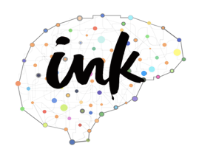


Neuro-Symbolic Commonsense Reasoning for Natural Language Processing
Yuchen Lin
Ph.D. Student
INK Research Lab
University of Southern California
yuchen.lin@usc.edu
Fudan University, June 2020

Slide 2
What is Commonsense Reasoning (CSR)?
Teach machines to reason with common sense!
The human ability to understand and generate everyday scenarios in our daily life.
The computation process of manipulating commonsense knowledge to make compositional logical inference.
  Physical world and logics
  Human behaviors / social conventions
Notes:
Generally, we think CSR is to teach machines to reason with common sense. I know! This definition is quite vague, right? Like, what do you mean by “reason” and what do you mean by “commonsense”. Yeah, it IS very hard to give a very clear definition of this area.
Because CSR is not like MT or IE, which have very clear problem settings and you know the input and output, then you only focus on the methods part.
But in CSR, people are still proposing new problems, as they have different explanation of commonsense and reasoning.
Fortunately, we do have some common beliefs: 1) CSR is a human …, 2) and from another perspective, it is also a computation process of ….
And we know the scope of the knowledge

Slide 3
A Biased View of Commonsense Reasoning
Hayes&McCarthy
Frame Problem
Programs with Common Sense
(1959)
Brooks
Subsumption
Quillian
Semantic Networks
John McCarthy
ConceptNet
Minsky, Filmore
Frames
McCarthy
Formalizing Commonsense
Description Logic
Bobrow
STUDENT
Simon&Newell
General Problem Solver
Lenant
Cyc
Winograd
SHRDLU
2000 1990 1980 1970 1960 1950 1940
Common Sense Reasoning was formulated
traditionally as a “reasoning” process, irrespective of learning and the resulting knowledge representation.
Khardon & Roth
Learning to Reason
Credit: Dan Roth

Slide 4
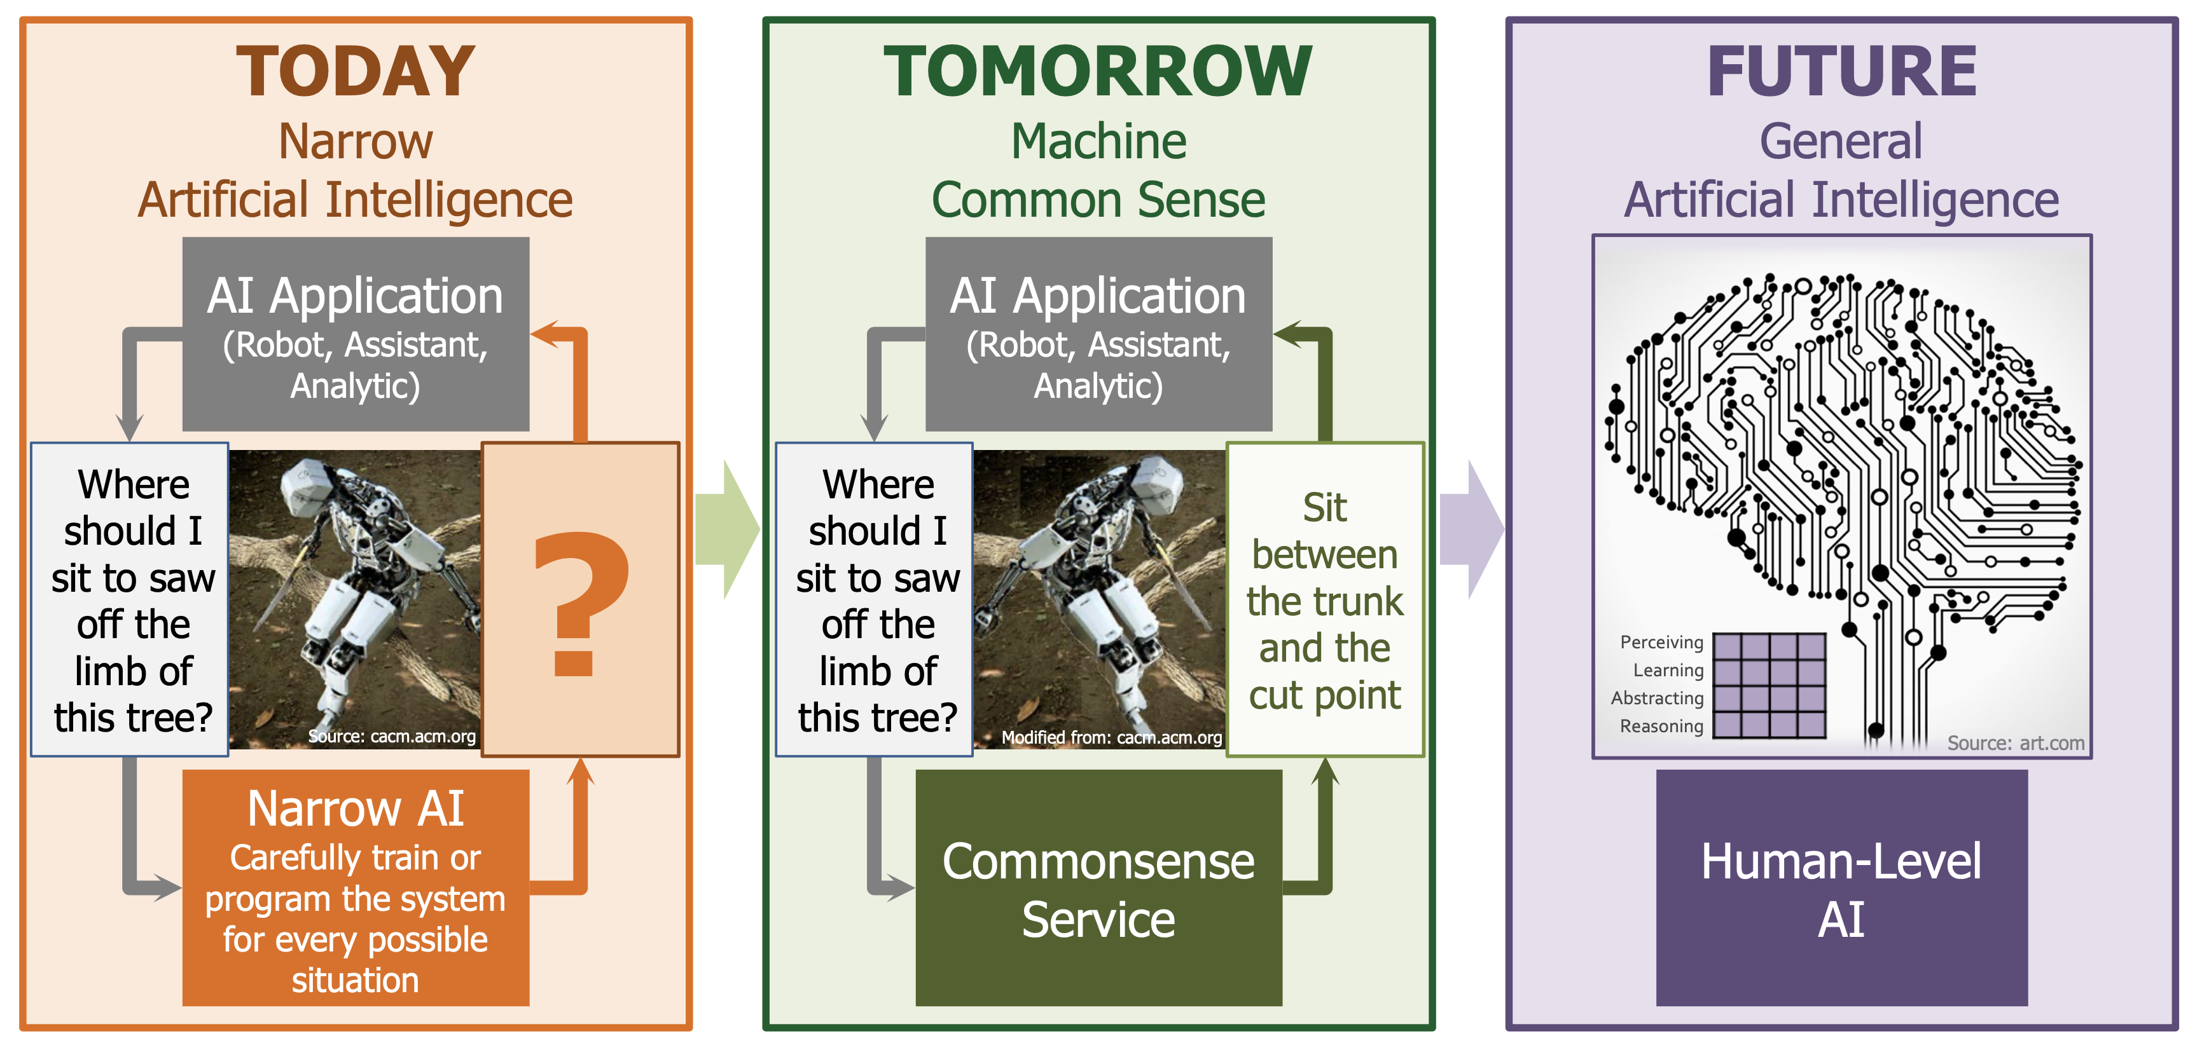
Why do we care about CSR?
Credit: https://www.darpa.mil/program/machine-common-sense

Slide 5
Example CSR problems in NLP
NLU: Multi-choice QA (w/o context)
Where do adults usually use glue sticks?
A: classroom B: office C: desk drawer
NLG: Constrained Sentence Generation (w/ a set of keywords)
Generate a daily-life scene about a concept-set: {apple, bag, tree}
A boy picks some apples from a tree and puts them into a bag.

Slide 6
Outline
Part I: Discriminative Commonsense Reasoning
  Improving NLU with commonsense
  Models: KagNet and MHGRN
  Analysis and future directions
Part II: Generative Commonsense Reasoning
  Imposing commonsense to NLG
  A new task & dataset: CommonGen
  Methods and Evaluation
Part III: Ongoing work for Next-Generation CSKG

Slide 7
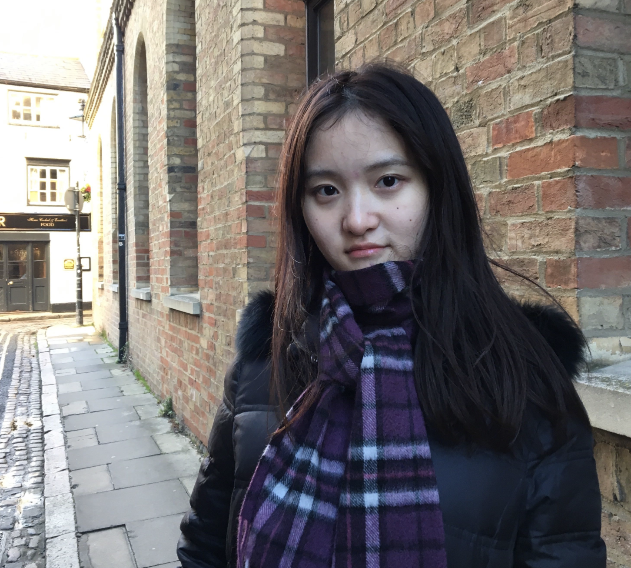


Part I
KagNet:
Knowledge-Aware Graph Networks
for Commonsense Reasoning
Bill Yuchen Lin Xinyue Chen Jamin Chen Xiang Ren
University of Southern California - Information Science Institution
INK Lab @ USC-ISI
http://inklab.usc.edu
EMNLP-IJCNLP 2019
Hong Kong, China

Slide 8
Commonsense Question Answering
Where do adults usually use glue sticks?
A: classroom B: office C: desk drawer
What do you need to fill with ink to write notes on an A4 paper?
A: fountain pen B: printer C: pencil
Can you choose the most plausible answer based on daily life commonsense knowledge?
(Bill Yuchen Lin et al. 2019)

Slide 9
Commonsense Question Answering
Where do adults usually use glue sticks?
A: classroom B: office C: desk drawer
What do you need to fill with ink to write notes on an A4 paper?
A: fountain pen B: printer C: pencil
From the CommonsenseQA dataset (Talmor et al. NAACL 2019)
Research question:
How can we impose commonsense in NLU models?
(Bill Yuchen Lin et al. 2019)

Slide 10
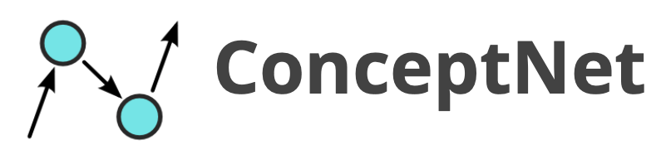
Knowledge-Aware Reasoning
adult
CapableOf
use
Symbol Space
ReceiveAction
CapableOf
glue_stick
work
HasSubevent
A Schema Graph
for the choice B
AtLocation
AtLocation
office
Grounding
Knowledge-Aware Reasoning*
Semantic Space
Where do adults use glue sticks?
Question
A: classroom B: office C: desk drawer
Answer Candidates
(Bill Yuchen Lin et al. 2019)

Slide 11
Challenges in knowledge-aware reasoning
How can we find the schema graphs?
  Noisy and Incomplete
  Numerous graphs; how to select the most related ones
How do we encode these graphs for reasoning?
  Complex multi-relational graph structures
  NO supervision in aligning graphs and question-answer pairs
  Need to be compatible with neural sentence encoders
(Bill Yuchen Lin et al. 2019)

Slide 12
Proposed Framework Overview
Statement
Question
Answer
Answer
Concepts
Question
Concepts
Concept Recognition
Language Encoder
(e.g. BERT)
Graph Construction
via Path Finding
KagNet
Statement Vector
Graph
Vector
Graph Encoder*
MLP
Plausibility score
Schema Graph
(Bill Yuchen Lin et al. 2019)

Slide 13
(1) Schema Graph Construction
Concept Recognition
  Tokenization / Lemmatization
  Match ConceptNet vocabulary
  Merge multiple smaller concepts into a longer one
    e.g. `` fountain’’, ``pen’’ --> ``fountain pen’’
  Question Concepts C_{q} and Answer Concepts C_{a}
Path Finding
  Find paths between each QA-concept pair (one from C_{q} and one from C_{a})
    denotes the set of paths between i-th question concept and j-th answer concept
  Path pruning by length (<= 5 nodes) and embedding-based metric.
    Train knowledge graph embeddings (e.g. TransE) for scoring paths
    Choose the highest-score relation by the KGE when there are multiple ones
，
(Bill Yuchen Lin et al. 2019)

Slide 14
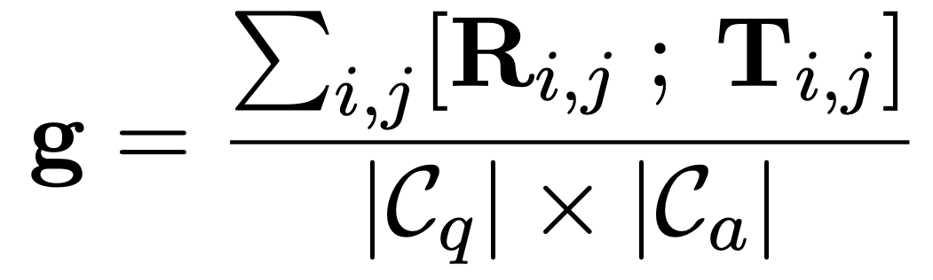
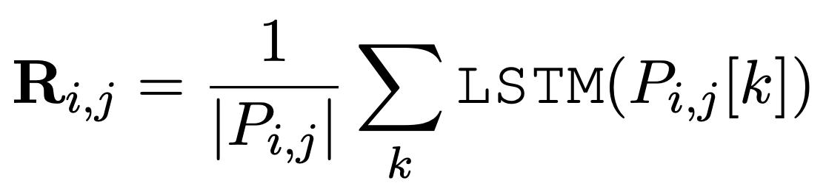
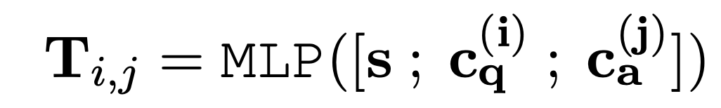

(2) Path-based Relational Graph Encoder
Encoding Unlabeled
Schema Graphs
Statement Vector
LSTM Path Encoder
LSTM( )
…..
Graph Conv. Nets
Modeling Relational Paths between
and
only looking at
the plain graph structures
(i.e. ignore relations)
the k-th path between
and
(Bill Yuchen Lin et al. 2019)

Slide 15
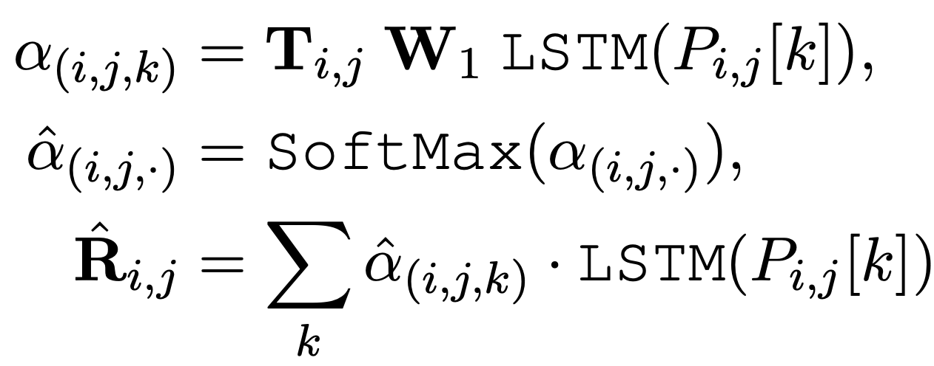
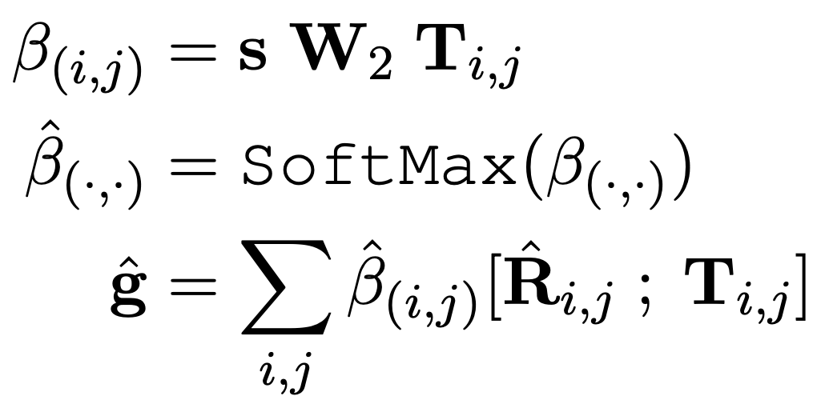
(3) w/ Hierarchical Path-based Attention
Two average pooling:
  Assuming all QA-concept pairs are equally important
  Assuming all paths are equally relevant
Modeling the two-level importance as latent weights:
Path-Level Attention
(attending on semantic space)
ConceptPair-Level Attention
(attending on statement)
(Bill Yuchen Lin et al. 2019)

Slide 16
Recap: Proposed Framework
Statement
Question
Answer
Answer
Concepts
Question
Concepts
Concept Recognition
Language Encoder
(e.g. BERT)
Graph Construction
via Path Finding
KagNet
Statement Vector
Graph
Vector
Graph Encoder*
MLP
Plausibility score
Schema Graph
(Bill Yuchen Lin et al. 2019)

Slide 17
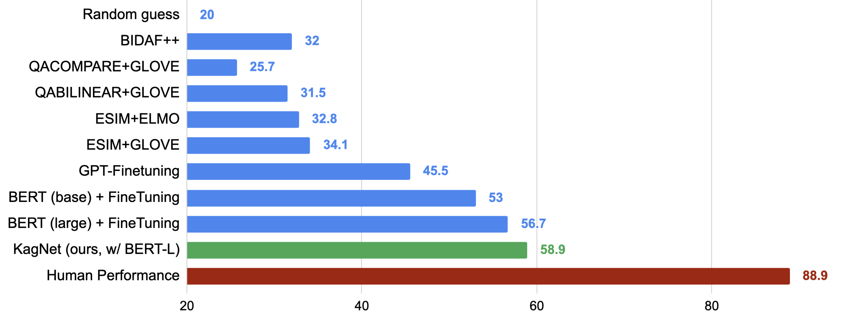
Experiments
Recent follow-up submissions:
Based on XL-NET / RoBERTa (72.1)
Using large-scale wiki docs via IR
Transfer from other QA datasets (e.g. RACE)
Adversarial Data Augmentation
More Performance on Official Test Set: https://www.tau-nlp.org/csqa-leaderboard
(Bill Yuchen Lin et al. 2019)

Slide 18
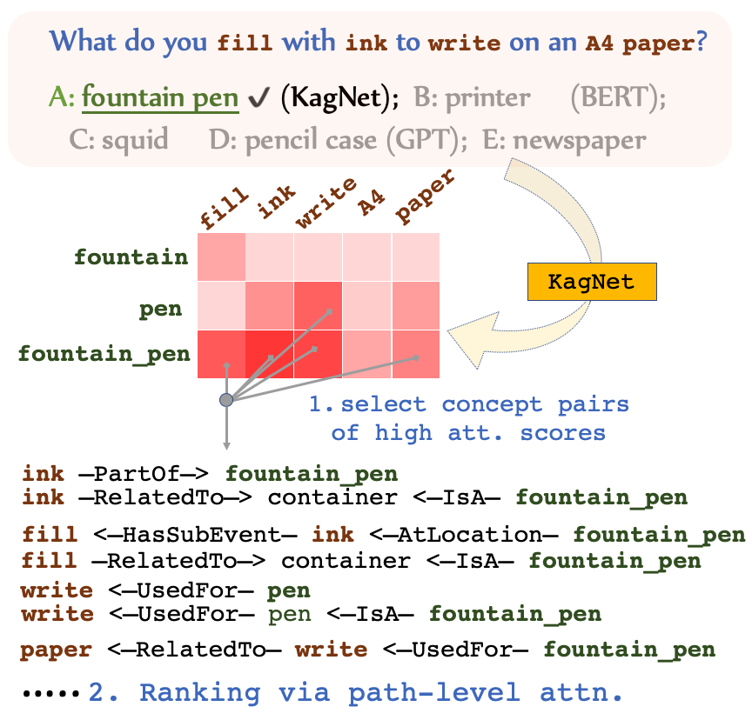


Interpretability
Transferability
KagNet
BERT-Large
Training!
CSQA
59.01% vs 56.53%
53.51% vs 51.23%
SWAG
No Training!
WSC
(Bill Yuchen Lin et al. 2019)

Slide 19
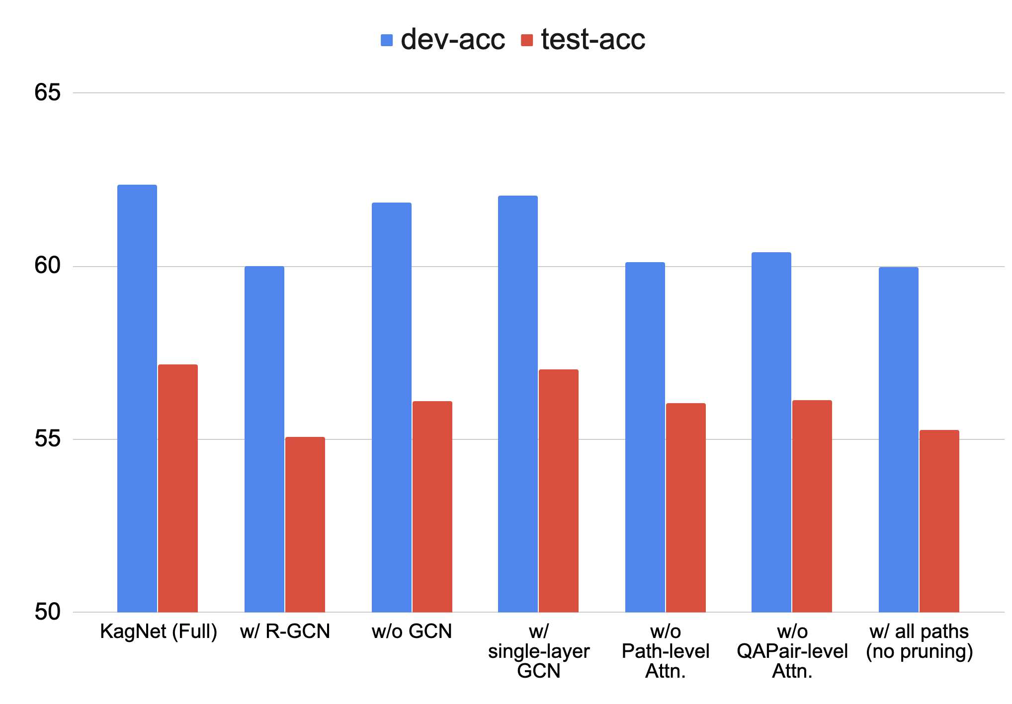
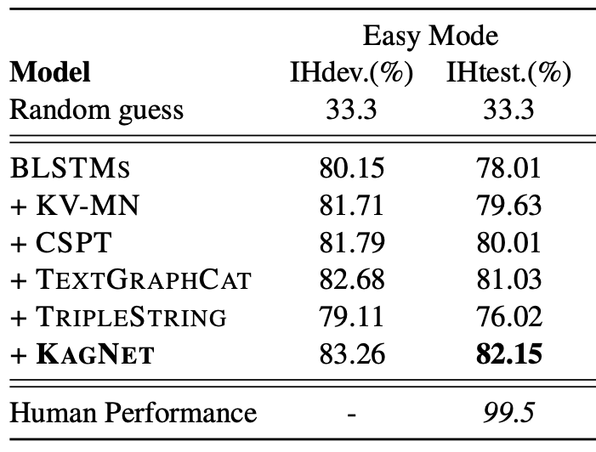
Experiments (cont.)
Easy mode:
wrong answers include some random chosen concepts
Comparisons with other knowledge-aware methods
KV-MN = (Mihaylov and Frank, ACL 18)
CSPT = (Zhong et al. 2019)
TextGraphCat = (Wang et al. AAAI 18)
TripleString = Transform triples to sentences
Ablation Study: R-GCN, # of layers, # Attentions
(Bill Yuchen Lin et al. 2019)

Slide 20
Conclusion
A novel framework for knowledge-aware commonsense QA
A graph neural network for relational reasoning.
  GCN + Path-based LSTM + Hierarchical Attention
  Promising for other reasoning tasks over graphs (e.g. GQA)
Future directions in commonsense reasoning:
  Towards Learnable Graph Construction (instead of heuristic algs.)
  Explicitly deal with negations (“not”, “but”, etc.) and comparisons (“largest”, “most”, etc.).
    Logical forms, executable semantic parsing.
  Interactively reasoning over a sequence of questions
Our code is at https://github.com/INK-USC/KagNet
(Bill Yuchen Lin et al. 2019)

Slide 21
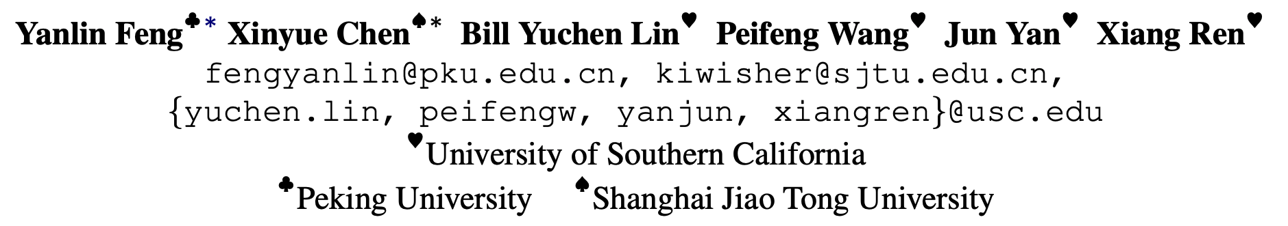
Multi-Hop Graph Relation Networks
for Knowledge-Aware Question Answering
https://arxiv.org/abs/2005.00646

Slide 22
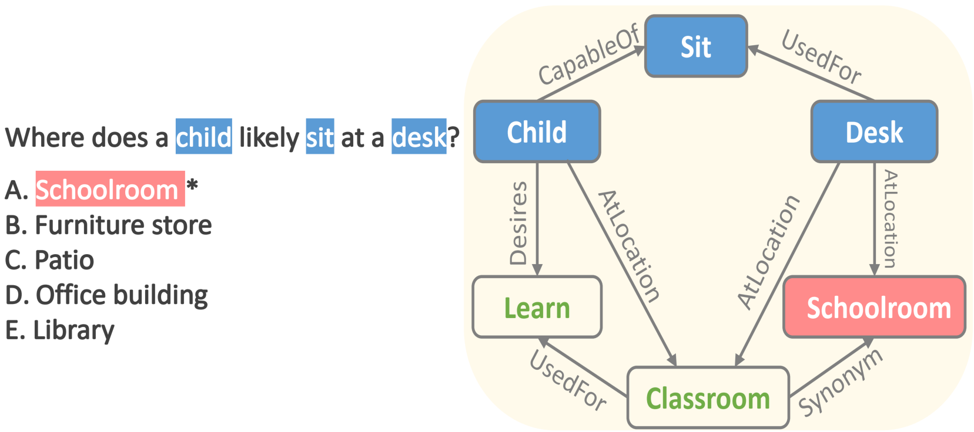
Motivation
KG-Augmented Commonsense QA:
Leverage KG to provide knowledge which is not stated explicitly in the context.
1. Extract the paths/subgraph localized at the entities mentioned in the context from KG.
2. Encode the paths/subgraph.
Previous works on encoding paths/sub-graph
    Path-based Modeling
1. Model the relational paths with sequence model.
2. Use attention to aggregate the paths.
Interpretable, but not scalable.
Relational Graph NN
Model the subgraph with message passing.
Scalable, but lack transparency
Key idea: Modeling All Paths Directly in Graph Networks!

Slide 23
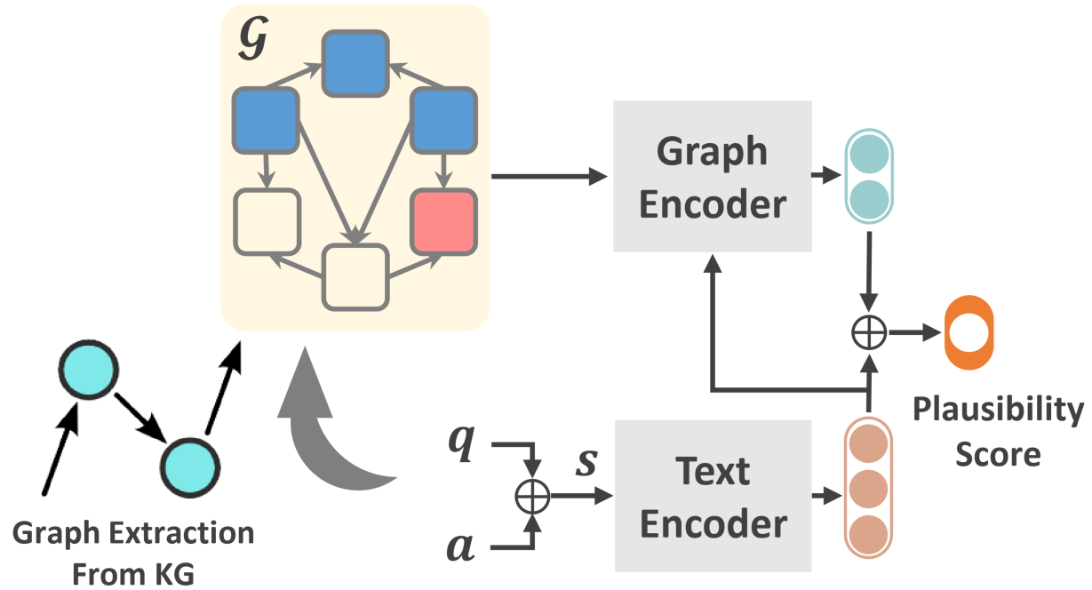
Reasoning Pipeline
1. Text Encoder: Understand the textual input (question + answer choice).
2. Graph Encoder: Reason over the contextual subgraphs.
3. Classifier: Integrate the output from text/graph encoder to give a plausibility score.

Slide 24
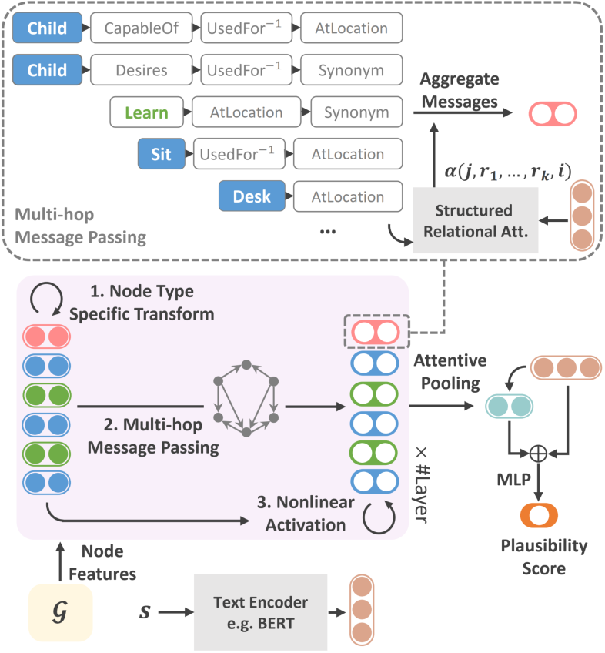
Our Method for Encoding KG
Goal: To combine both interpretability (path-based modeling) and scalability (GNN).
How: Endow GNN with the capability to model paths directly.
Multi-Hop Message Passing
  We extend message passing in GNN to k-hop paths modeling.
2. Structured Relational Attention
Incoming message for a node is aggregated by attention mechanism.

Slide 25

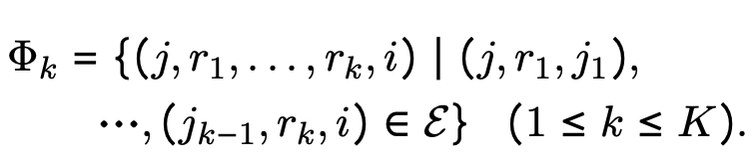
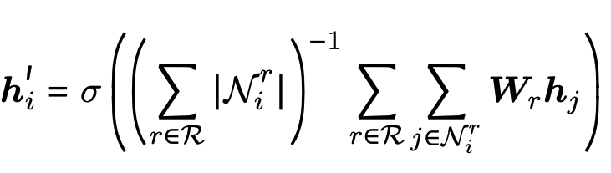
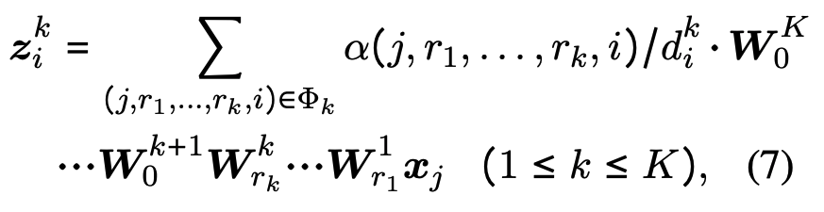

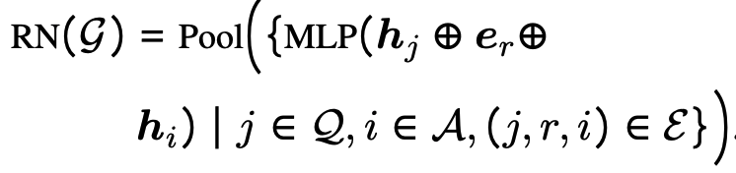

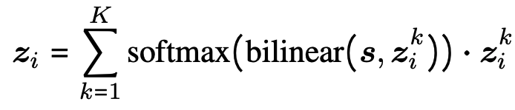
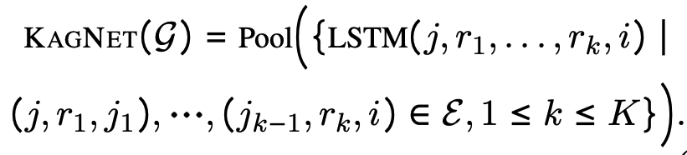

Our Method for Encoding KG
Multi-Hop Graph Relation Nets (Ours)
Relational GNN (e.g., R-GCN)
low-rank approximation
Relation Networks (DeepMind, NIPS17)
KagNet (paths are pre-filtered)

Slide 26
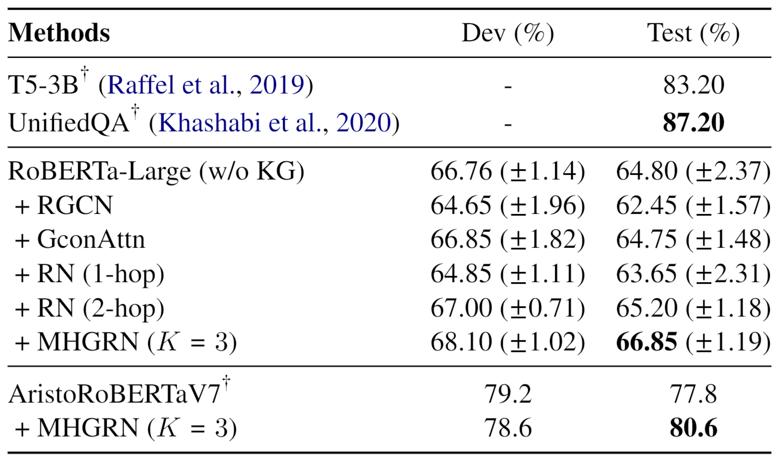
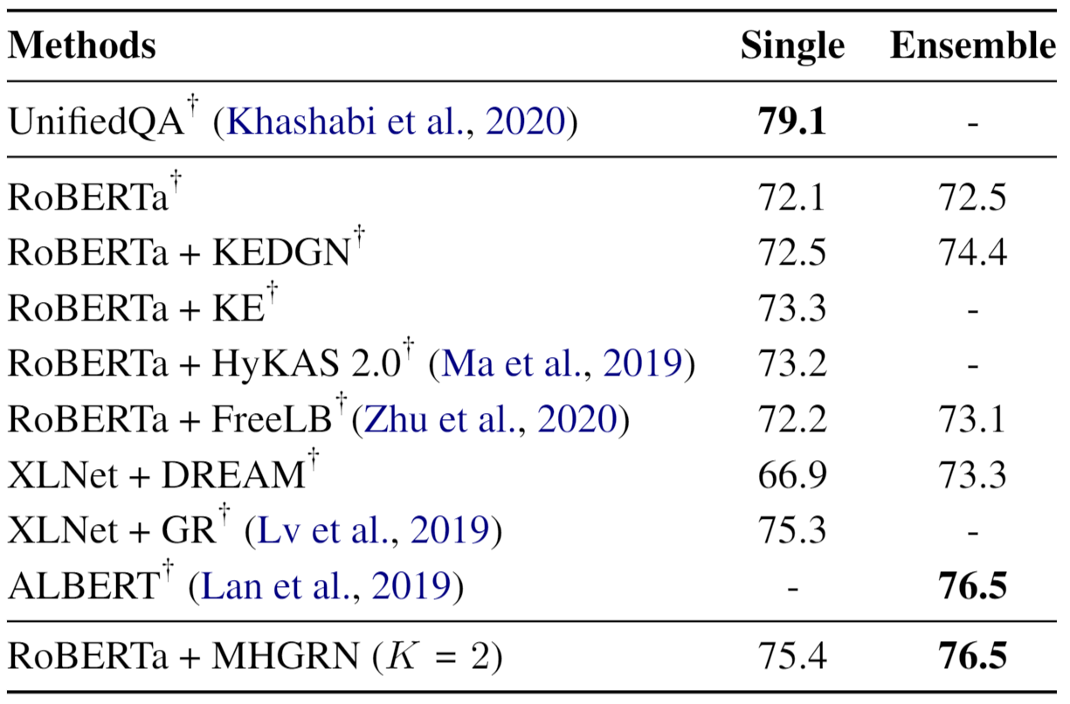
Results
CommonsenseQA’s Leaderboard
OpenBookQA’s Leaderboard

Slide 27
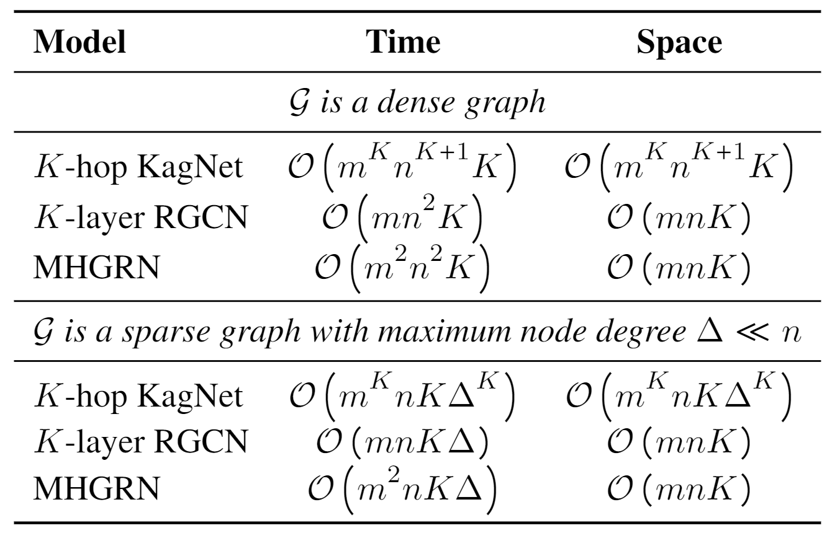
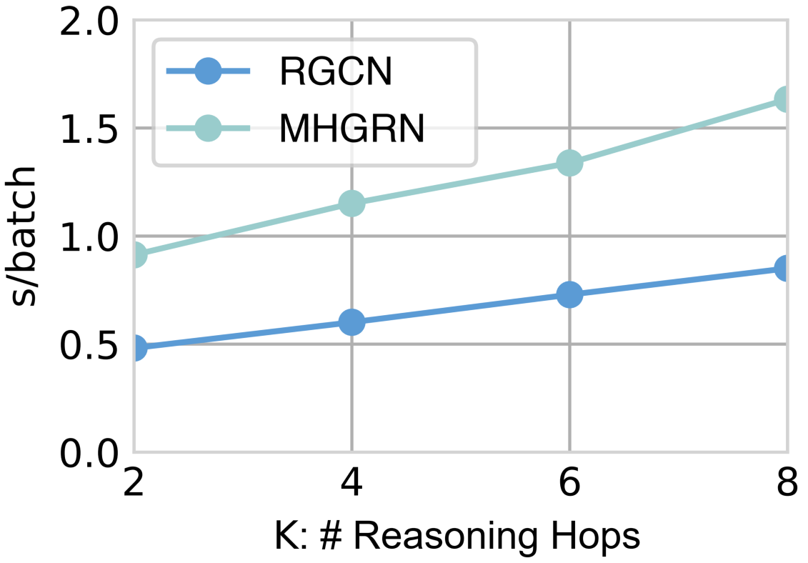
Results
Scalability

Slide 28
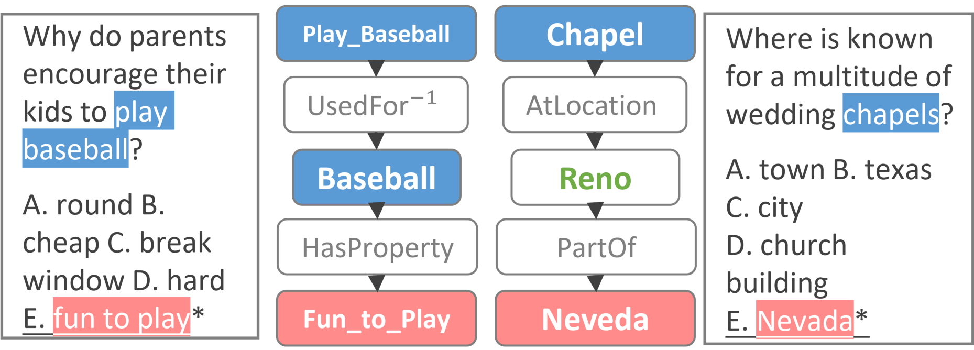
Results
Interpretability

Slide 29
Code: https://github.com/INK-USC/MHGRN

Slide 30
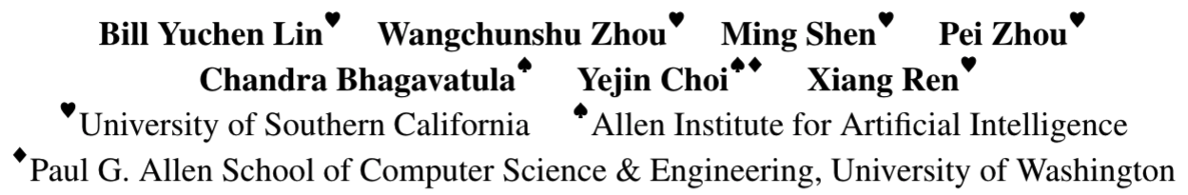


Part II
CommonGen:
A Constrained Text Generation Challenge for Generative Commonsense Reasoning
https://inklab.usc.edu/CommonGen/

Slide 31
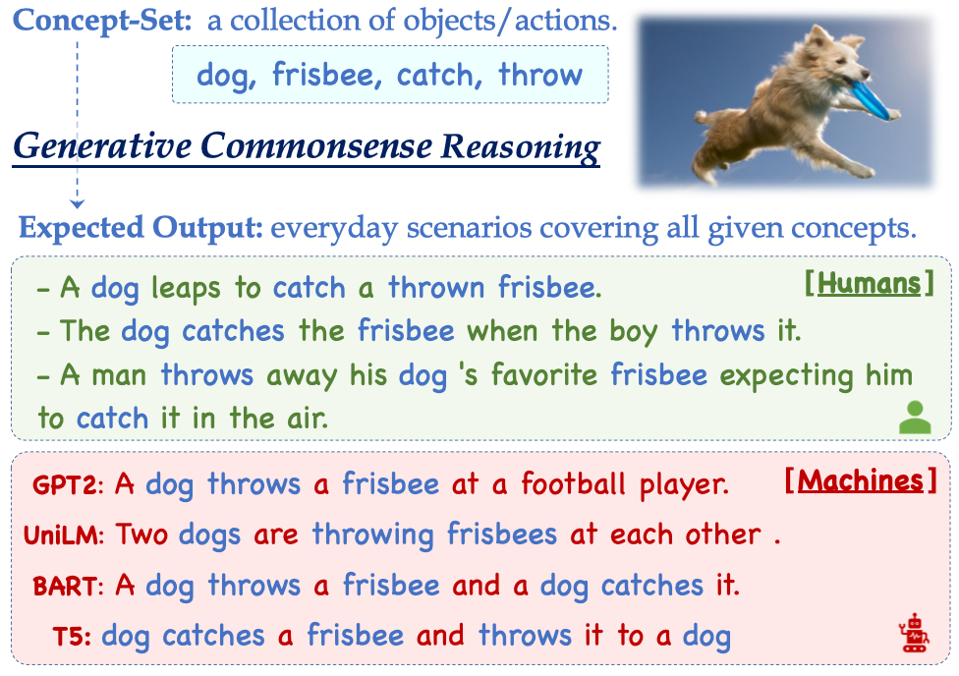
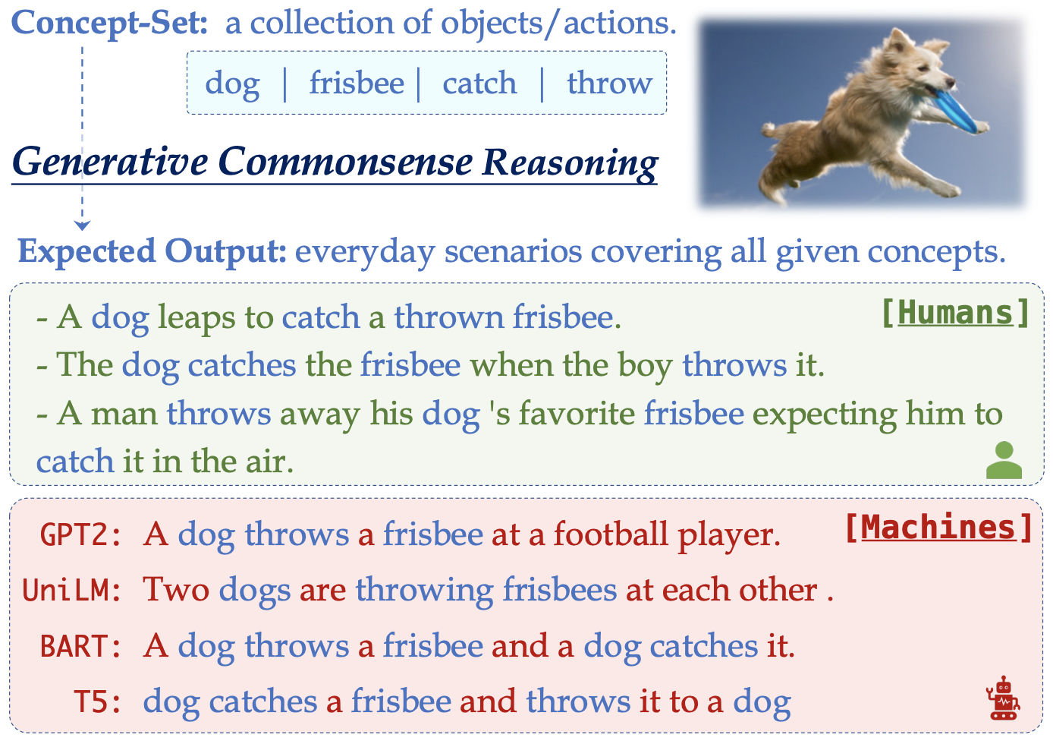
What is CommonGen?
Most current tasks for machine commonsense focus on discriminative reasoning.
  CommonsenseQA, SWAG.
Humans not only use commonsense knowledge for understanding text, but also for generating sentences.
Input:
  A set of common concepts (actions & objects)
Output:
  A sentence that describes an everyday scenario the given concepts.
Notes:
What motivates our research is that most current commonsense reasoning tasks mainly focus on discriminative reasoning problems.
Such as Commonsense QA, and SWAG dataset.
However, humans not only use their common sense for understanding text, but also for generating sentences.
We thus propose a new dataset named CommonGen.
As we can see an input is concept-set, which is a collection of object and action words.
For example, a dog, a frisbee, the action catch and throw.
The desired output is a sentence that describes an everyday scenario in our daily life using as many given concepts as possible.
A simple example is that “A dog catches the frisbee when the boy throws it.”

Slide 32
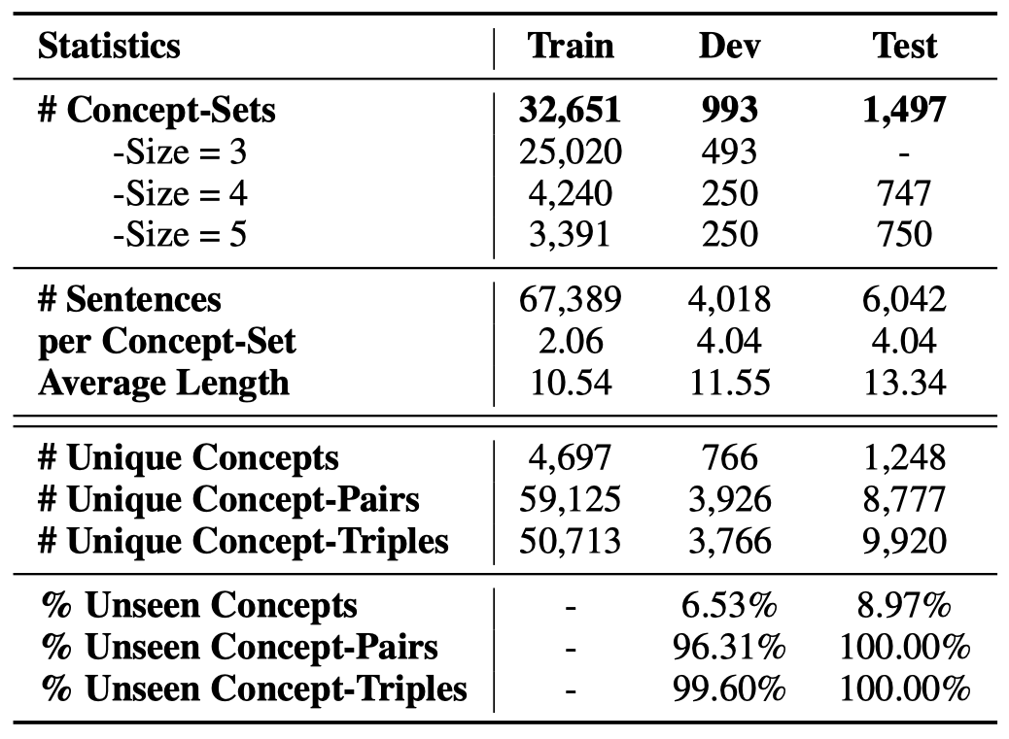
Construction

Slide 33
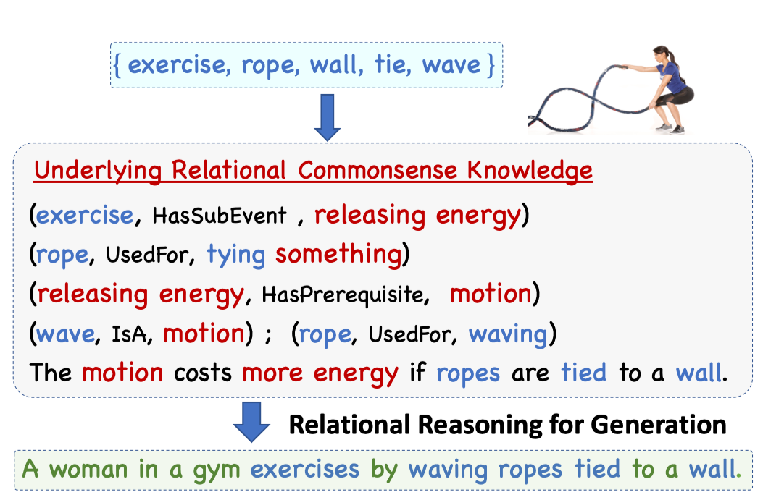
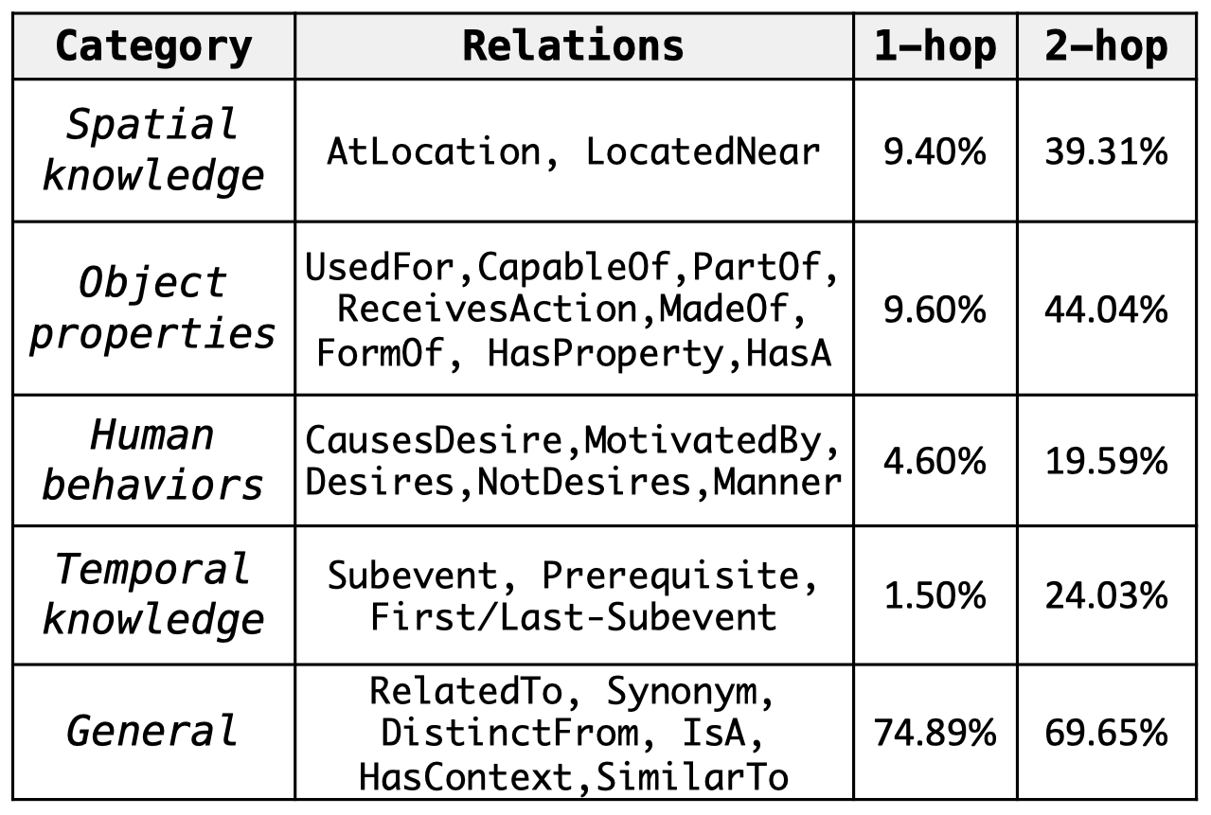
Why is it hard?
Two key Challenges of CommonGen
(1) Relational knowledge are latent and compositional.
Notes:
Why is this problem hard?
First of all, it needs much relational commonsense knowledge about given concepts, and they are latent and compositional.
We can see that for this particular real example in our dataset, we need know a list of facts and find the best composition of them for writing the sentence
“A woman in a gym exercises by waving ropes tied to a wall.”
We analyzed our dataset and find that it covers different types of knowledge such as spatial, properties, human behaviors, temporal knowledge and others.

Slide 34
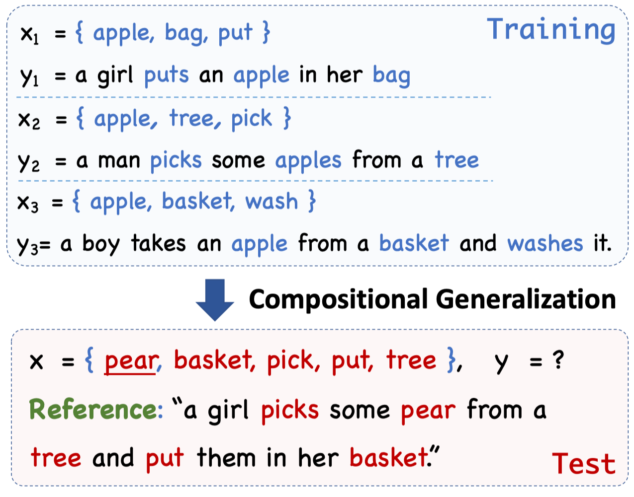
Why is it hard?
Two key Challenges of CommonGen
(2) Compositional Generalization for unseen concept compounds.
Unseen Concept in Training
Notes:
Second, the dataset needs compositional generalization ability so that it can work for unseen combinations of concepts.
For example, in the training time, we can see such examples, about apple, bag, put, tree, pick, basket, wash.
However, in the testing time, the model needs to deal with a more challenging example like this one.
The model has never seen the concept pear in the training, or the combinations of any two of them.
Here are some statistics for our dataset, and note that all the concept-pairs in the test concept-sets are not shown in the training before.

Slide 35
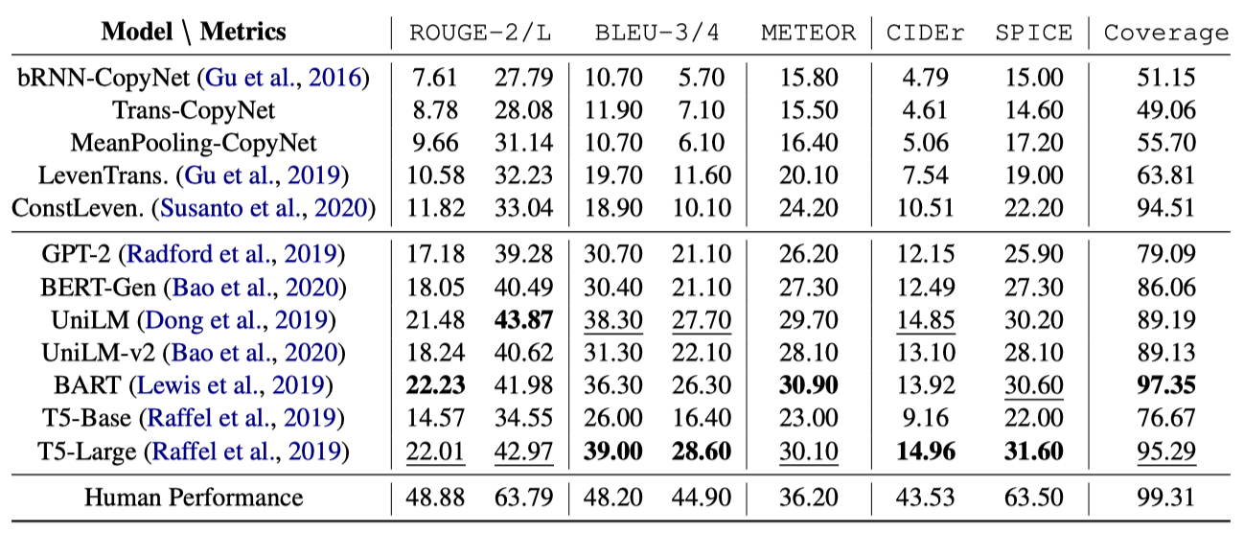
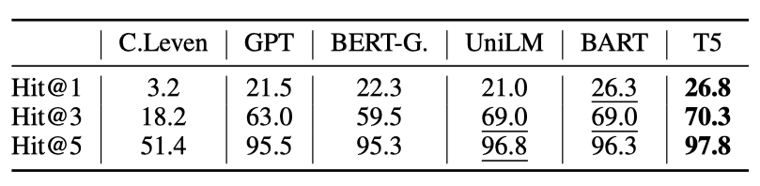
Experimental Results
(1)
Seq2seq models
(2)
Fine-tuning
pre-trained
LMs
(3)
Agreement
Manual Eval.
Notes:
We tested a comprehensive list of models on the dataset.
These are the experimental results with several automatic metrics.
We also did manual evaluation by asking humans to compare and rank the model generations.
In the end, we find that T5-large, after fine-tuning, performs the best, but it is still far from human performance.

Slide 36
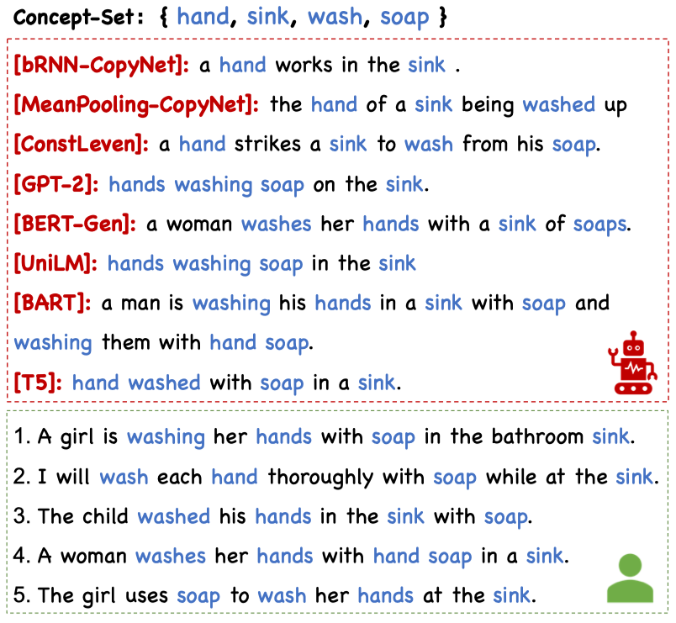
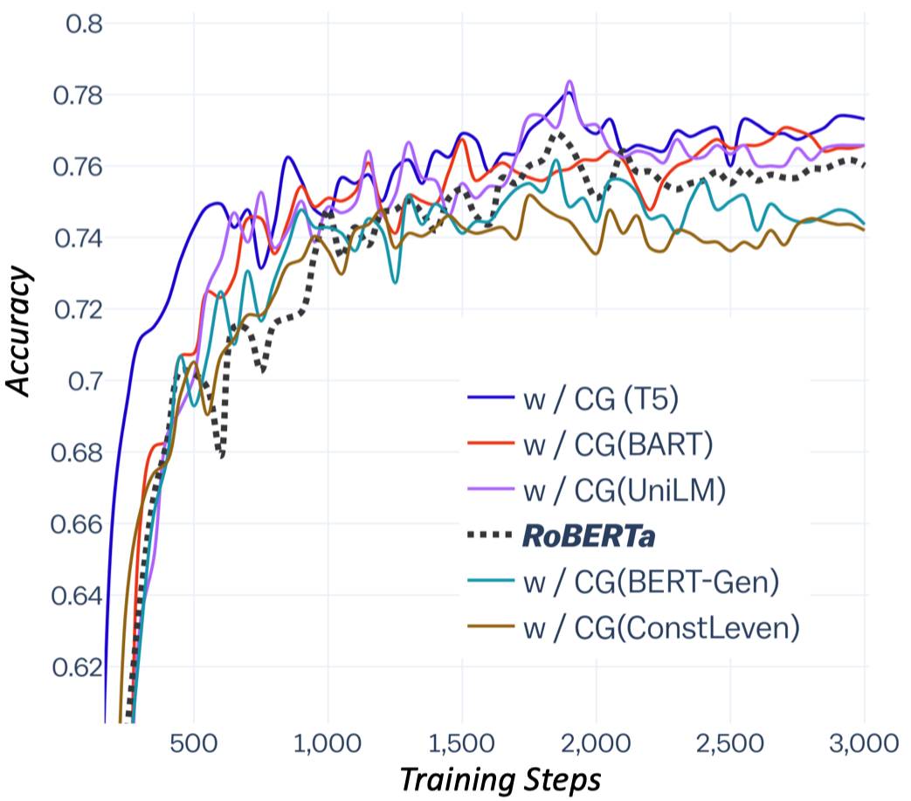
Case Study & Transfer Learning
Learning curve for the transferring study (acc on dev). We use trained CommonGen models to generate choice-speciﬁc context for the CommonsenseQA task.
Notes:
This is a case study for qualitative analysis of the model results.
We can see that there is still a gap between models and humans.
More interestingly, we use these models to generate additional choice-specific context for a QA task.
We find that better models like T5, BART and UniLM can generate very beneficial evidences and thus improve the downstream applications.

Slide 37
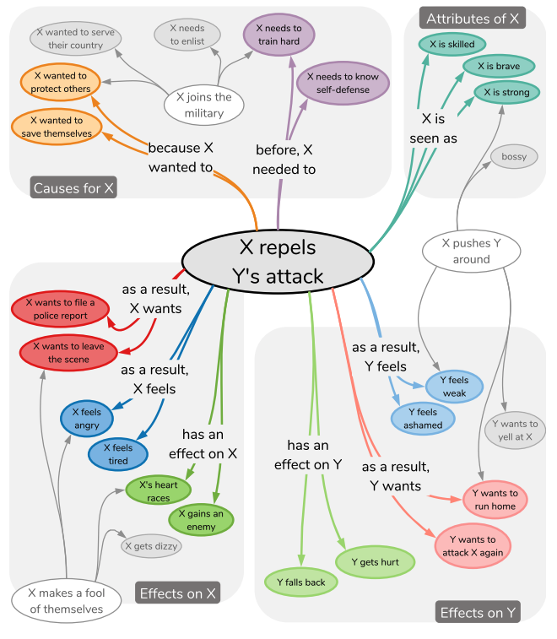
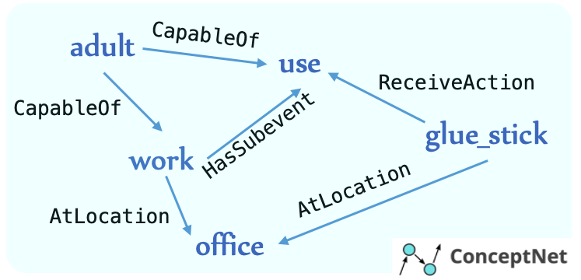
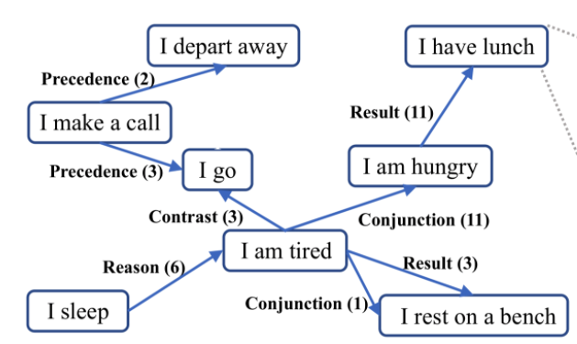
Ongoing work: Next-Generation Commonsense Knowledge Base
ConceptNet
ATOMIC
ASER

Slide 38
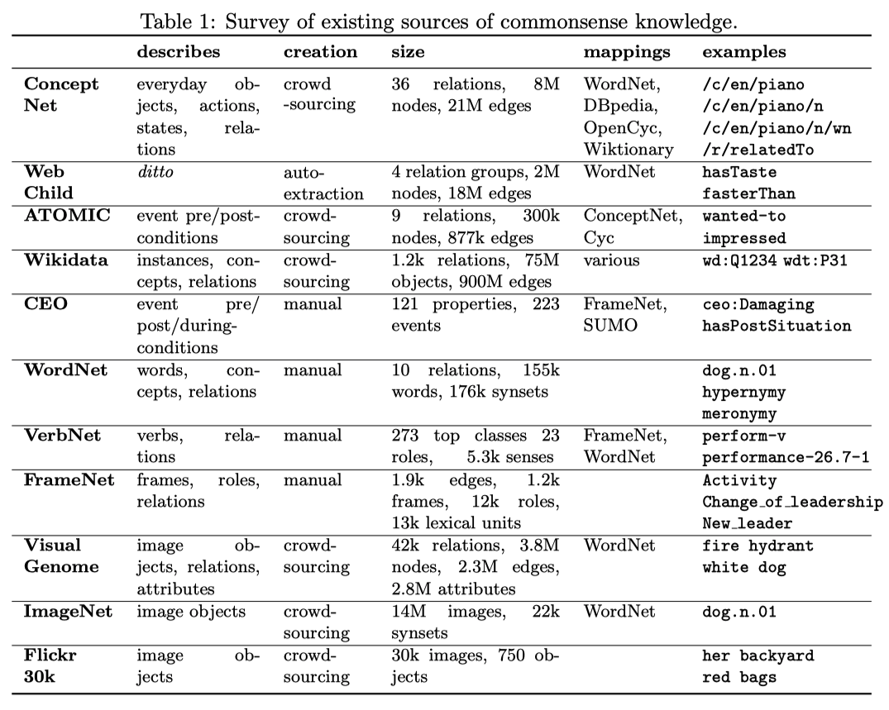
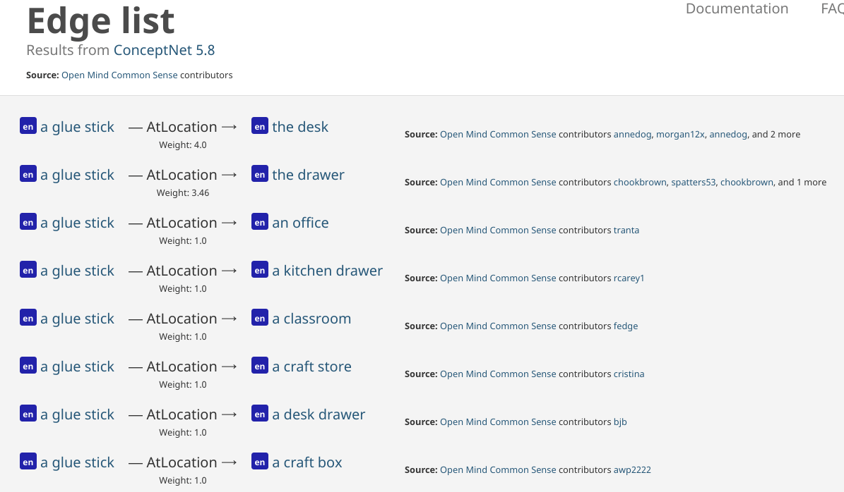
Background: Symbolic Commonsense Knowledge Graphs
Advantages of these symbolic CSKGs:
Support formal queries Query(glue_stick, AtLocation, ?)
Easy to maintain (adding/removing/editing facts)

Slide 39

Background: Disadvantages of Symbolic CSKGs
Natural Language Queries with Complex Compositions
Q: What do you need to use to place a piece of paper on a door?
Correct Answers: [glue_stick, tape, pin, …., knife, ….]
What if we Query(?, UsedFor, placing_a_peice_of_paper_on_a_door)?
These overly specific triples may not (and should not) exist in symbolic commonsense knowledge graphs.
Despite the weakness from the symbolic nature, current CSKGs also are:
Limited relations: out of the 42 relations in ConceptNet, there are only around 17 unique semantics.
Highly incomplete: e.g. “tape”, “pin” do not have such triples.
  Most of the triples are in the RelatedTo relation, which is vague for reasoning.
  Many relations (e.g. LocatedNear) only have hundreds of triplets.
Noisy: many triples are not typical knowledge (e.g., <cat, CapableOf, looking_at_a _king> with a weight of 4.47, while <cat, CapableOf, chase_mice> only weigh 1.0).
Inflexible to facts that are not easy to be represented as triples: “Most trees add one new ring for each year of growth.”

Slide 40
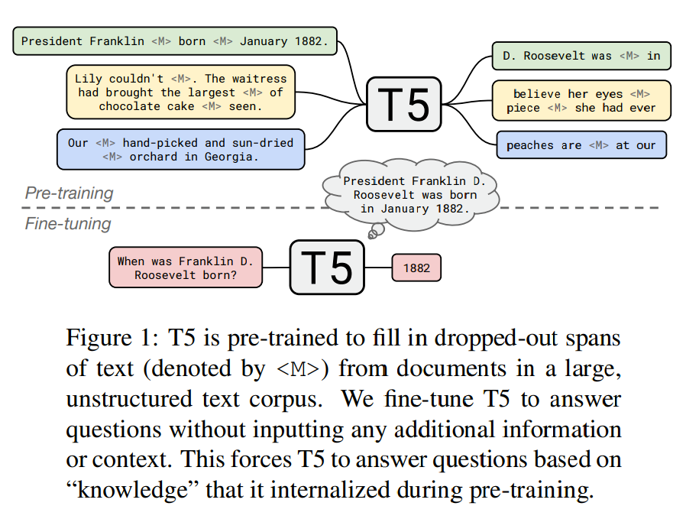
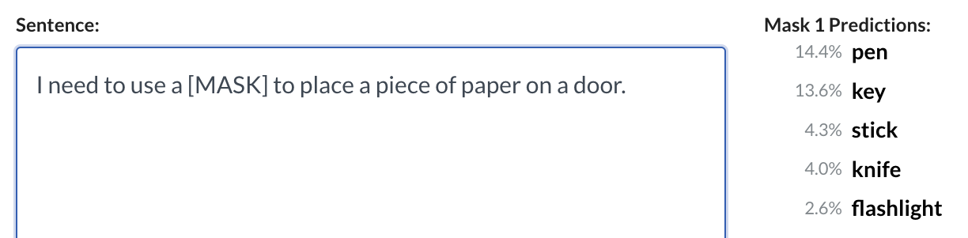
Background: Pre-trained LMs as neural (CS)KGs?
Advantages of such neural CSKGs:
Flexible in querying with natural languages
Query understanding with neural contextual representations
  attach … to ~= place .. on;
Can be further fine-tuned towards specific data for downstream applications
Disadvantages:
Induced facts may not be faithful or interpretable
Inability to answer complex questions w/o fine-tuning
Lacks of transparency, thus Not debuggable
1) LAMA probes (Petroni et al. EMNLP 2019)
2) Fine-tuning T5 for QA (Roberts et al. 2020)

Slide 41
Directly Use a Text Corpus as KG?
A high-quality corpus of generic facts.
High-precision (Dependency/AMR) parser
Consolidate parses of the corpus and find frequent schema.
  e.g., schema:0 = {1: noun} <--nsubj– {2: verb} --{dobj}--> {3: noun}
    (1:student, 2: read, 3: textbooks) ---> schema:0
    (1:student, 2: buy, 3: textbooks) ---> schema:0
  Originally:
    (student, CapableOf, read_book),
    (student, CapableOf (?), buy_book)
N-ary, slot-filling-style knowledge hyper-graphs
Pre-trained Neural Interface for Quering?

Slide 42
Thank you very much for listening!

